Slide 1
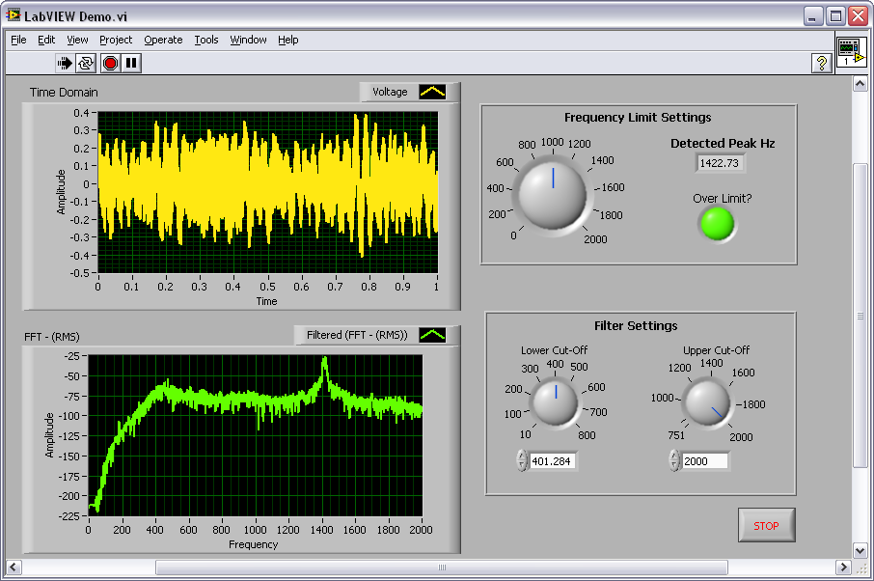
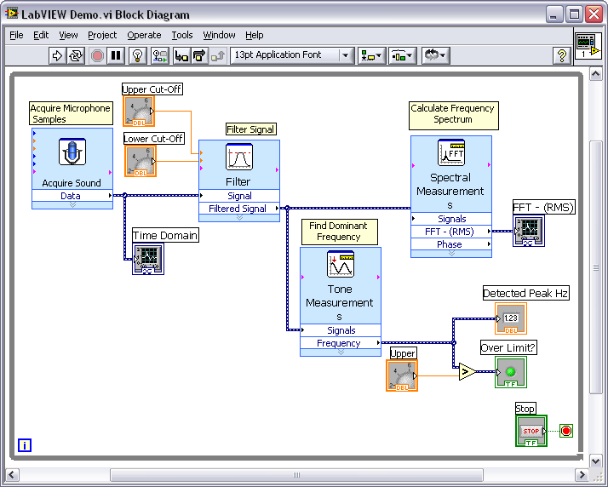
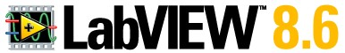
6-Hour Hands-On
Introduction to LabVIEW
GRAPHICAL PROGRAMMING
FOR ENGINEERS AND SCIENTISTS
Notes:
© National Instruments Corporation 1 Introduction to LabVIEW Hands-On

Slide 2
Course Goals
Become comfortable with the LabVIEW environment and data flow execution
Ability to use LabVIEW to solve problems
LabVIEW Concepts
Acquiring, saving and loading data
Find and use math and complex analysis functions
Work with data types, such as arrays and clusters
Displaying and printing results
Notes:
This is a list of the objectives of the course.
This course prepares you to do the following:
• Use LabVIEW to create applications.
• Understand front panels, block diagrams, and icons and connector panes.
• Use built-in LabVIEW functions.
• Create and save programs in LabVIEW so you can use them as subroutines.
• Create applications that use plug-in DAQ devices.
This course does not describe any of the following:
• Programming theory
• Every built-in LabVIEW function or object
• Analog-to-digital (A/D) theory
NI does provide free reference materials on the above topics on ni.com.
The LabVIEW Help is also very helpful:
LabVIEW»Help»Search the LabVIEW Help…
Introduction to LabVIEW Hands-On 2 ni.com

Slide 3
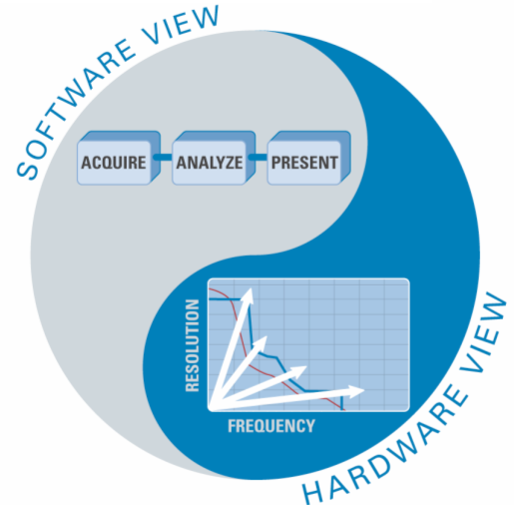
The Virtual Instrumentation Approach
Notes:
Virtual Instrumentation
For more than 30 years, National Instruments has revolutionized the way engineers and scientists in industry, government, and academia approach measurement and automation. Leveraging PCs and commercial technologies, virtual instrumentation increases productivity and lowers costs for test, control, and design applications through easy-to-integrate software, such as NI LabVIEW, and modular measurement and control hardware for PXI, PCI, USB, and Ethernet.
With virtual instrumentation, engineers use graphical programming software to create user-defined solutions that meet their specific needs, which is a great alternative to proprietary, fixed-functionality traditional instruments. Additionally, virtual instrumentation capitalizes on the ever-increasing performance of personal computers. For example, in test, measurement, and control, engineers have used virtual instrumentation to downsize automated test equipment (ATE) while experiencing up to a 10 times increase in productivity gains at a fraction of the cost of traditional instrument solutions. Last year 25,000 companies in 90 countries invested in more than 6 million virtual instrumentation channels from National Instruments.
© National Instruments Corporation 3 Introduction to LabVIEW Hands-On

Slide 4
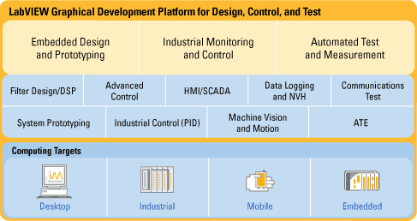
LabVIEW Graphical Development System
Graphical programming environment
Compile code for multiple OS and devices
Useful in a broad range of applications
Notes:
National Instruments LabVIEW is an industry-leading software tool for designing test, measurement, and control systems. Since its introduction in 1986, engineers and scientists worldwide who have relied on NI LabVIEW graphical development for projects throughout the product design cycle have gained improved quality, shorter time to market, and greater engineering and manufacturing efficiency. By using the integrated LabVIEW environment to interface with real-world signals, analyze data for meaningful information, and share results, you can boost productivity throughout your organization. Because LabVIEW has the flexibility of a programming language combined with built-in tools designed specifically for test, measurement, and control, you can create applications that range from simple temperature monitoring to sophisticated simulation and control systems. No matter what your project is, LabVIEW has the necessary tools to make you successful quickly.
Introduction to LabVIEW Hands-On 4 ni.com

Slide 5

Virtual Instrumentation Applications
Design
Signal and image processing
Embedded system programming
(PC, DSP, FPGA, microcontroller)
Simulation and Prototyping
And more …
Control
Automatic controls and dynamic systems
Mechatronics and robotics
And more …
Measurements
Circuits and electronics
Measurements and instrumentation
And more …
A single graphical development platform
Design
Prototype
Deploy
Notes:
Virtual Instrumentation Applications
Virtual instrumentation is effective in many different types of applications, from design to prototyping to deployment. The LabVIEW platform provides specific tools and models to meet specific application challenges, ranging from designing signal processing algorithms to making voltage measurements, and can target any number of platforms from the desktop to embedded devices – with an intuitive, powerful graphical paradigm.
With Version 8.6, LabVIEW scales from design and development on PCs to several embedded targets, from rugged toaster-size prototypes to embedded systems on chips. LabVIEW streamlines system design with a single graphical development platform. In doing so, it encompasses better management of distributed, networked systems because as the targets for LabVIEW grow varied and embedded, you need to be able to more easily distribute and communicate between the various LabVIEW code pieces in your system.
© National Instruments Corporation 5 Introduction to LabVIEW Hands-On

Slide 6
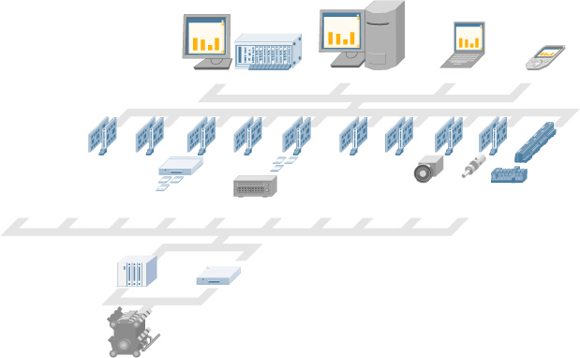
The NI Approach – Integrated Hardware Platforms
PXI Modular Instrumentation
Desktop PC
Laptop PC
PDA
High-Speed
Digitizers
High-Resolution
Digitizers and DMMs
Multifunction
Data Acquisition
Dynamic
Signal Acquisition
Instrument
Control
Digital I/O
Counter/
Timers
Machine
Vision
Motion
Control
Distributed I/O and
Embedded Control
Signal Conditioning
and Switching
Unit Under Test
Notes:
Integrated Hardware Platforms
A virtual instrument consists of an industry-standard computer or workstation equipped with powerful application software, cost-effective hardware such as plug-in boards, and driver software, which together perform the functions of traditional instruments.
Virtual instruments represent a fundamental shift from traditional hardware-centered instrumentation systems to software-centered systems that exploit the computing power, productivity, display, and connectivity capabilities of popular desktop computers and workstations.
Although the PC and integrated circuit technology have experienced significant advances in the last two decades, software truly offers the flexibility to build on this powerful hardware foundation to create virtual instruments, providing better ways to innovate and significantly reduce cost. With virtual instruments, engineers and scientists build measurement and automation systems that suit their needs exactly (user-defined) instead of being limited by traditional fixed-function instruments (vendor-defined).
Introduction to LabVIEW Hands-On 6 ni.com

Slide 7
Section I – LabVIEW Environment
A. Getting Data into Your Computer
Data Acquisition Devices
NI-DAQmx
Simulated data acquisition
Sound card
B. LabVIEW Environment
Front Panel/Block Diagram
Toolbar/Tools Palette
C. Components of a LabVIEW Application
Creating a VI
Dataflow Execution
D. Additional Help
Finding Functions
Tips for Working in LabVIEW
Notes:
© National Instruments Corporation 7 Introduction to LabVIEW Hands-On

Slide 8
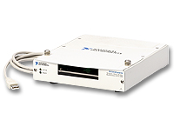
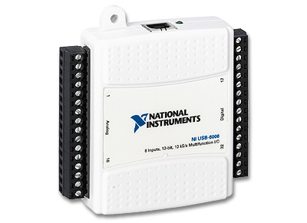
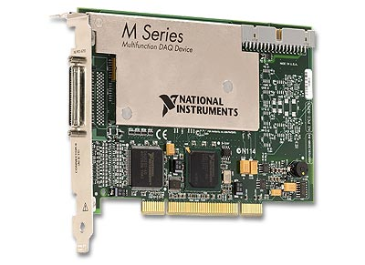
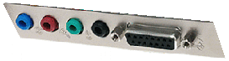
A. Setting Up Your Hardware
Data Acquisition Device (DAQ)
Actual USB, PCI, or PXI Device
Configured in Measurement and Automation Explorer(MAX)
Simulated Data Acquisition Device (DAQ)
Software simulated at the driver level
Configured in MAX
Sound Card
Built into most computers
Track A
Track B
Track C
Notes:
This LabVIEW course is designed for audiences with or without access to National Instruments hardware.
Each exercise is divided into three tracks, A, B, and C:
Track A is designed to be used with hardware supported by the NI-DAQmx driver. This includes most USB, PCI, and PXI data acquisition devices with analog input. Some signal conditioning and excitation (external power) is required to use a microphone with a DAQ device.
Track B is designed to be used with no hardware. You can simulate the hardware with NI-DAQmx Version 8.0 and later. This is done by using the NI-DAQmx Simulated Device option in the Create New menu of MAX. The simulated device’s driver is loaded, and programs using it are fully verified.
Track C is designed to be used with a standard sound card and microphone. LabVIEW includes simple VIs for analog input and analog output using the sound card built into many PCs. This is convenient for laptops because the sound card and microphone are usually already built-in.
Introduction to LabVIEW Hands-On 8 ni.com

Slide 9
Do Not Delete
Notes on hardware setup
Notes:
Track A – NI Data Acquisition with Microphone: USB-6009, Microphone and LED
Suggested Hardware
The following schematic was drawn with NI Multisim, a widely used SPICE schematic capture and simulation tool. Visit ni.com/Multisim for more info.
Setting Up Your Hardware for Your Selected Track
Track B – Simulated NI Data Acquisition: NI-DAQmx Software Version 8.0 or later
Track C – Third-Party Sound card: Sound card and Microphone
Suggested Hardware
* Laptops often have a built-in microphone (no plug-in microphone is required)
© National Instruments Corporation 9 Introduction to LabVIEW Hands-On

Slide 10
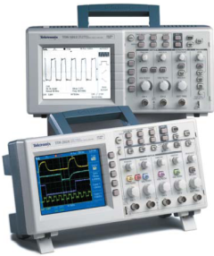
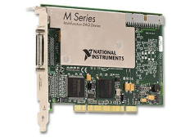
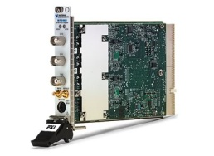
What Type of Device Should I Use?
 | Sound Card* | NI USB DAQ | NI PCI DAQ | Instruments*
AI Bandwidth | 8 to 44 kS/s | 10 kS/s to 1.25 MS/s | 20 kS/s to 10 MS/s | 100 S/s to 2 GS/s
Accuracy | 12 to 16 bits | 12 to 18 bits | 12 to 18 bits | 8 to 26 bits
Portable | √ | √ | — | some
AI Channels | 2 | 8 to 80 | 2 to 80 | 1 to 80
AO Channels | 2 | 2 to 4 | 2 to 8 | 2 to 8
AC or DC | AC | AC/DC | AC/DC | AC/DC
Triggering | — | √ | √ | √
Calibrated | — | √ | √ | √
* The above table may not be representative of all device variations that exist in each category
Notes:
What type of device should I use?
There are many types of data acquisition and control devices on the market. A few have been highlighted above. The trade-off usually falls between sampling rate (samples/second), resolution (bits), number of channels, and data transfer rate (usually limited by “bus” type: USB, PCI, PXI, and so on). Multifunction DAQ (data acqusion) devices are ideal because they can be used in a wide range of applications.
NI USB-6008 and USB-6009 Low-Cost USB DAQ
The National Instruments USB-6009 device provides basic data acquisition functionality for applications such as simple data logging, portable measurements, and academic lab experiments. The USB-6008 and USB-6009 are ideal for students. Create your own measurement application by programming the USB-6009 using LabVIEW and NI-DAQmx driver software for Windows. For Mac OS X and Linux® users, download and use the NI-DAQmx Base driver.
USB-6009 Specifications:
Eight 14-bit analog inputs
12 digital I/O lines
2 analog outputs
1 counter
ni.com/daq
Introduction to LabVIEW Hands-On 10 ni.com
Linux® is the registered trademark of Linus Torvalds in the U.S. and other countries.

Slide 11
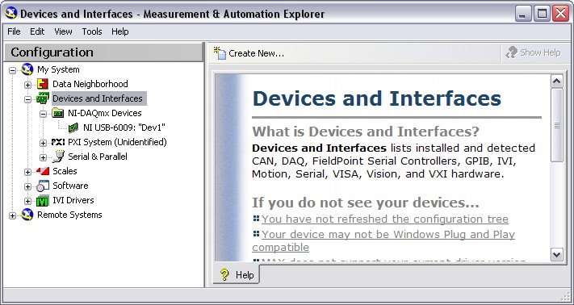
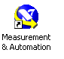
What is MAX?
Stands for Measurement & Automation Explorer
Configures and organizes all your National Instruments DAQ, PCI/PXI, GPIB, IMAQ, IVI, motion, VISA, and VXI devices
Tests devices
Icon Found on
Windows Desktop
Notes:
The next level of software is called Measurement & Automation Explorer (MAX). MAX is a software interface that gives you access to all of your National Instruments DAQ, GPIB, IMAQ, IVI, Motion, VISA, and VXI devices. The shortcut to MAX appears on your desktop after installation. A picture of the icon is shown above. MAX is mainly used to configure and test your National Instruments hardware, but it does offer other functionality such as checking to see if you have the latest version of NI-DAQmx installed. When you run an application using NI-DAQmx, the software reads the MAX configuration to determine the devices you have configured. Therefore, you must configure DAQ devices first with MAX.
The functionality of MAX falls into six categories:
Data Neighborhood
Devices and Interfaces
IVI Instruments
Scales
Historical Data
Software
This course will focus on Data Neighborhood, Devices and Interfaces, Scales, Software, and learn about the functionality each one offers.
© National Instruments Corporation 11 Introduction to LabVIEW Hands-On

Slide 12
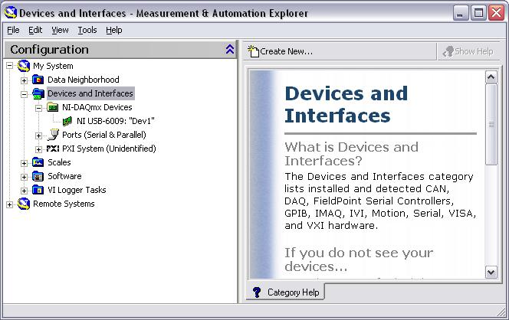
Exercise 1 – Setting Up Your Device
Use Measurement and Automation Explorer (MAX) to:
Configure and test your Data Acquisition (DAQ) device
Track A
Notes:
Exercise 1.1 – Testing Your Device (Track A)
In this exercise, use Measurement and Automation Explorer (MAX) to test
your USB-6009 DAQ device.
1. Launch MAX by double-clicking the icon on the desktop or by selecting Start»Programs»National Instruments»Measurement & Automation.
2. Expand the Devices and Interfaces section to view the installed National Instruments devices. MAX displays the National Instruments hardware and software in the computer.
3. Expand the NI-DAQmx Devices section to view the installed hardware that is compatible with NI-DAQmx. The device number appears in quotes following the device name. The data acquisition VIs use this device number to determine which device performs DAQ operations. Your hardware is listed as NI USB-6009: “Dev1.”
Perform a self-test on the device by right-clicking it in the configuration tree and choosing Self-Test or clicking “Self-Test” along the top of the window. This tests the system resources assigned to the device. The device should pass the test because it is already configured.
Check the pinout for your device. Right-click the device in the configuration tree and select Device Pinouts or click “Device Pinouts” along the top of the center window.
Open the test panels. Right-click the device in the configuration tree and select Test Panels… or click “Test Panels…” along the top of the center window. With test panels, you can test the available functionality of your device, analog input/output, digital input/output, and counter input/output without doing any programming.
On the Analog Input tab of the test panels, change Mode to “Continuous” and Rate to “10,000 Hz.” Click “Start” and hum or whistle into your microphone to observe the signal that is plotted. Click “Stop” when you are done.
On the Digital I/O tab, notice that initially the port is configured to be all input. Observe under Select State the LEDs that represent the state of the input lines. Click the “All Output” button under Select Direction. Notice you now have switches under Select State to specify the output state of the different lines. Toggle line 0 and watch the LED light up. Click “Close” to close the test panels.
Close MAX.
Introduction to LabVIEW Hands-On 12 ni.com

Slide 13
Do Not Delete Exercise Instructions
Notes:
(End of Exercise)
© National Instruments Corporation 13 Introduction to LabVIEW Hands-On

Slide 14
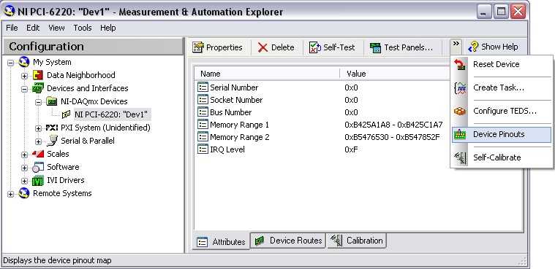
Exercise 1 – Setting Up Your Device
Use Measurement and Automation Explorer (MAX) to:
Configure and test your Simulated Data Acquisition (DAQ) device
Track B
Notes:
Exercise 1.1 – Setting Up Your Device (Track B)
In this exercise, use Measurement and Automation Explorer (MAX) to configure a simulated DAQ device.
Launch MAX by double-clicking the icon on the desktop or by selecting Start»Programs»National Instruments»Measurement & Automation.
Expand the Devices and Interfaces section to view the installed National Instruments devices. MAX displays the National Instruments hardware and software in the computer. The device number appears in quotes following the device name. The data acquisition VIs use this device number to determine which device performs DAQ operations.
Create a simulated DAQ device for use later in this course. Simulated devices are a powerful tool for development without having hardware physically installed in your computer. Right-click Devices and Interfaces and select Create New…»NI-DAQmx Simulated Device. Click “Finish.” The simulated device appears yellow in color.
Expand the M Series DAQ section. Select PCI-6220 or any other PCI device of your choice. Click “OK.”
The NI-DAQmx Devices folder expands to show a new entry for PCI-6220: “Dev1.” You have now created a simulated device.
Perform a self-test on the device by right-clicking it in the configuration tree and choosing Self-Test or clicking “Self-Test” along the top of the window. This tests the system resources assigned to the device. The device should pass the test because it is already configured.
Check the pinout for your device. Right-click the device in the configuration tree and select Device Pinouts or click “Device Pinouts” along the top of the center window.
Open the test panels. Right-click the device in the configuration tree and select Test Panels… or click “Test Panels…” along the top of the center window. The test panels allow you to test the available functionality of your device, analog input, digital input/output, and counter input/output without doing any programming.
On the Analog Input tab of the test panels, change Mode to “Continuous.” Click “Start” and observe the signal that is plotted. Click “Stop” when you are done.
Introduction to LabVIEW Hands-On 14 ni.com

Slide 15
Do Not Delete Exercise Instructions
Notes:
10. On the Digital I/O tab, notice that initially the port is configured to be all input. Observe under Select State the LEDs that represent the state of the input lines. Click the “All Output” button under Select Direction. Note that you now have switches under Select State to specify the output state of the different lines. Click “Close” to close the test panels.
11. Close MAX.
(End of Exercise)
© National Instruments Corporation 15 Introduction to LabVIEW Hands-On

Slide 16
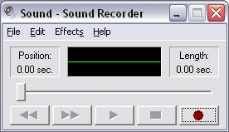
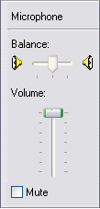
Exercise 1 – Setting Up Your Device
Use Windows to:
Verify your Sound Card
Un-Mute Microphone
Track C
Notes:
Exercise 1.1 – Setting Up Your Device (Track C)
In this exercise, use Windows utilities to verify your sound card and prepare it for use with a microphone.
Prepare your microphone for use. Double-click the volume control icon on the task bar to open up the configuration window. You also can find the sound configuration window from the Windows Control Panel: Start Menu»Settings»Control Panel»Sounds and Audio Devices»Advanced.
If you do not see a microphone section, go to Options»Properties»Recording and place a checkmark in the box next to Microphone. This displays the microphone volume control. Click “OK.”
Uncheck the Mute box if it is not already unchecked. Make sure that the volume is turned up.
Close the volume control configuration window.
Open the sound recorder by selecting Start»Programs»Accessories»Entertainment»Sound Recorder.
Click the record button and speak into your microphone. Notice how the sound signal is displayed in the sound recorder.
Click stop and close the sound recorder without saving changes when you are finished.
Uncheck Mute
(End of Exercise)
Introduction to LabVIEW Hands-On 16 ni.com

Slide 17
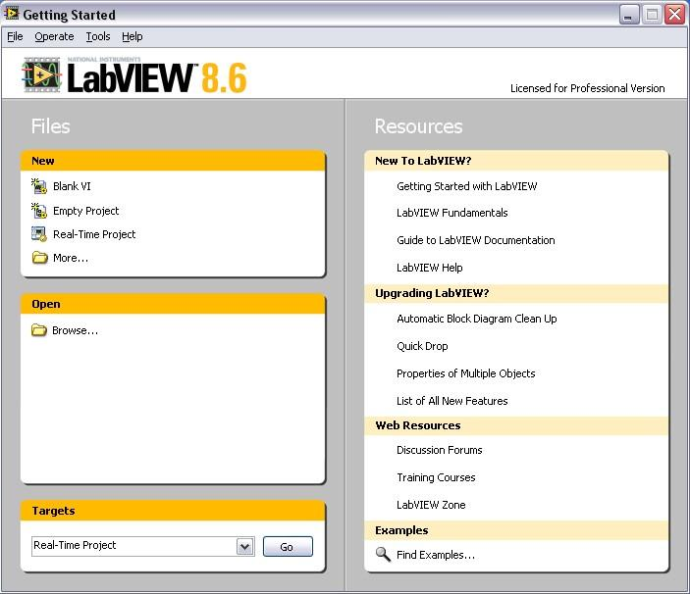
Open and Run LabVIEW
Start»All Programs»National Instruments LabVIEW 8.6
»
Startup Screen:
Start from a blank VI:
New»Blank VI
Start from an example:
Examples»Find Examples…
or
Notes:
LabVIEW
LabVIEW is a graphical programming language that uses icons instead of lines of text to create applications. In contrast to text-based programming languages, where instructions determine program execution, LabVIEW uses dataflow programming, where the flow of data determines execution order.
You can purchase several add-on software toolkits for developing specialized applications. All the toolkits integrate seamlessly in LabVIEW. Refer to the National Instruments Web site for more information about these toolkits.
LabVIEW also includes several wizards to help you quickly configure your DAQ devices and computer-based instruments and build applications.
LabVIEW Example Finder
LabVIEW features hundreds of example VIs you can use and incorporate into VIs that you create. In addition to the example VIs that are shipped with LabVIEW, you can access hundreds of example VIs on the NI Developer Zone (zone.ni.com). You can modify an example VI to fit an application, or you can copy and paste from one or more examples into a VI that you create.
© National Instruments Corporation 17 Introduction to LabVIEW Hands-On

Slide 18
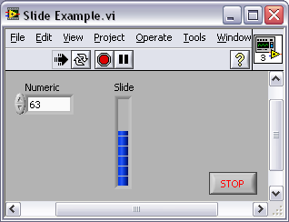
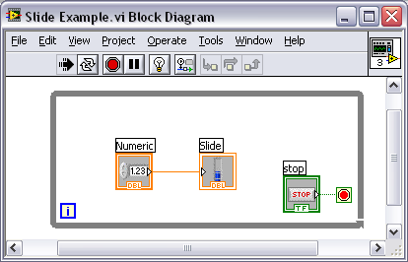
LabVIEW Programs Are Called Virtual Instruments (VIs)
Each VI has 2 windows
Front Panel
User interface (UI)
Controls = inputs
Indicators = outputs
Block Diagram
Graphical code
Data travels on wires from controls through functions to indicators
Blocks execute by data flow
Notes:
LabVIEW programs are called virtual instruments (VIs).
Controls are inputs and indicators are outputs.
Each VI contains three main parts:
Front panel – How the user interacts with the VI
Block diagram – The code that controls the program
Icon/connector – The means of connecting a VI to other VIs
In LabVIEW, you build a user interface by using a set of tools and objects. The user interface is known as the front panel. You then add code using graphical representations of functions to control the front panel objects. The block diagram contains this code. In some ways, the block diagram resembles a flowchart.
You interact with the front panel when the program is running. You can control the program, change inputs, and see data updated in real time. Controls are used for inputs such as adjusting a slide control to set an alarm value, turning a switch on or off, or stopping a program. Indicators are used as outputs. Thermometers, lights, and other indicators display output values from the program. These may include data, program states, and other information.
Every front panel control or indicator has a corresponding terminal on the block diagram. When you run a VI, values from controls flow through the block diagram, where they are used in the functions on the diagram, and the results are passed into other functions or indicators through wires.
Introduction to LabVIEW Hands-On 18 ni.com

Slide 19
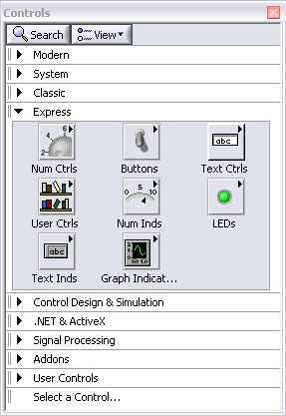
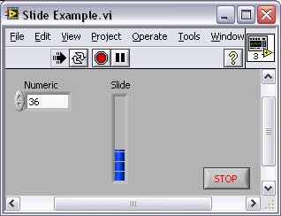
Controls Palette
(Place items on the front panel window)
Control:
Numeric
Customize Palette View
Indicator:
Numeric Slide
Notes:
Use the Controls palette to place controls and indicators on the front panel. The Controls palette is available only on the front panel. To view the palette, select Window»Show Controls Palette. You also can display the Controls palette by right-clicking an open area on the front panel. Tack down the Controls palette by clicking the pushpin on the top left corner of the palette.
© National Instruments Corporation 19 Introduction to LabVIEW Hands-On

Slide 20
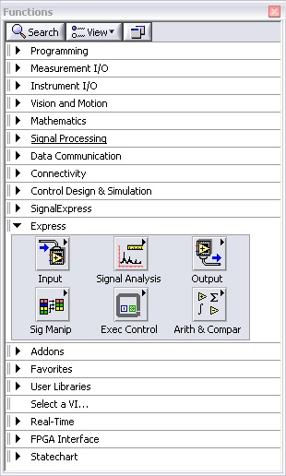
Functions (and Structures) Palette
(Place items on the
block diagram Window)
Structure:
While Loop
Notes:
Use the Functions palette to build the block diagram. The Functions palette is available only on the block diagram. To view the palette, select Window»Show Functions Palette. You also can display the Functions palette by right-clicking an open area on the block diagram. Tack down the Functions palette by clicking the pushpin on the top left corner of the palette.
Introduction to LabVIEW Hands-On 20 ni.com

Slide 21
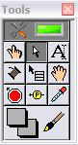
Tools Palette
Recommended: Automatic Selection Tool
Tools to operate and modify both front panel and block diagram objects
Automatic Selection Tool
Automatically chooses among the following tools:
Operating Tool
Positioning/Resizing Tool
Labeling Tool
Wiring Tool
Notes:
If you enable the automatic selection tool and you move the cursor over objects on the front panel or block diagram, LabVIEW automatically selects the corresponding tool from the Tools palette. Toggle automatic selection tool by clicking the Automatic Selection Tool button in the Tools palette.
Use the Operating Tool to change the values of a control or select the text within a control.
Use the Positioning Tool to select, move, or resize objects. The Positioning Tool changes shape when it moves over a corner of a resizable object.
Use the Labeling Tool to edit text and create free labels. The Labeling Tool changes to a cursor when you create free labels.
Use the Wiring Tool to wire objects together on the block diagram.
Other important tools:
© National Instruments Corporation 21 Introduction to LabVIEW Hands-On

Slide 22
Status Toolbar
Run Button
Continuous Run Button
Abort Execution
Additional Buttons on the Diagram Toolbar
Execution Highlighting Button
Retain Wire Values Button
Step Function Buttons
Notes:
Click the Run button to run the VI. While the VI runs, the Run button appears with a black arrow if the VI is a top-level VI, meaning it has no callers and therefore is not a subVI.
Click the Continuous Run button to run the VI until you abort or pause it. You also can click the button again to disable continuous running.
While the VI runs, the Abort Execution button appears. Click this button to stop the VI immediately.
Note: Avoid using the Abort Execution button to stop a VI. Either let the VI complete its data flow or design a method to stop the VI programmatically. By doing so, the VI is at a known state. For example, place a button on the front panel that stops the VI when you click it.
Click the Pause button to pause a running VI. When you click the Pause button, LabVIEW highlights on the block diagram the location where you paused execution. Click the Pause button again to continue running the VI.
Select the Text Settings pull-down menu to change the font settings for the VI, including size, style, and color.
Select the Align Objects pull-down menu to align objects along axes, including vertical, top edge, left, and so on.
Select the Distribute Objects pull-down menu to space objects evenly, including gaps, compression, and so on.
Select the Resize Objects pull-down menu to change the width and height of front panel objects.
Introduction to LabVIEW Hands-On 22 ni.com

Slide 23
Do Not Delete Exercise Instructions
Notes:
Select the Reorder pull-down menu when you have objects that overlap each other and you want to define which one is in front or back of another. Select one of the objects with the Positioning Tool and then select from Move Forward, Move Backward, Move To Front, and Move To Back.
Note: The following items only appear on the block diagram toolbar.
Click the Highlight Execution button to see the flow of data through the block diagram. Click the button again to disable execution highlighting.
Click the Retain Wire Values button to save the wire values at each point in the flow of execution so that when you place a probe on a wire, you can immediately obtain the most recent value of the data that passed through the wire.
Click the Step Into button to single-step into a loop, subVI, and so on. Single-stepping through a VI steps through the VI node to node. Each node blinks to denote when it is ready to execute. By stepping into the node, you are ready to single-step inside the node.
Click the Step Over button to step over a loop, subVI, and so on. By stepping over the node, you execute the node without single-stepping through the node.
Click the Step Out button to step out of a loop, subVI, and so on. By stepping out of a node, you complete single-stepping through the node and go to the next node.
Additional Tools:
Retain Wire Values
© National Instruments Corporation 23 Introduction to LabVIEW Hands-On

Slide 24
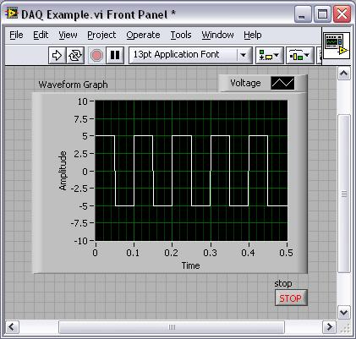
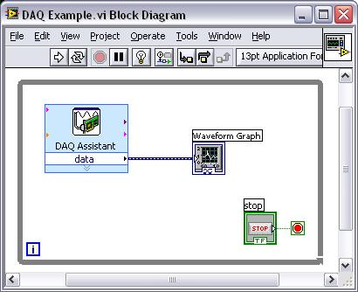
Demonstration 1: Creating a VI
Front Panel Window
Graph
Indicator
Block Diagram Window
Output
Terminal
Boolean
Control
Input
Terminals
Notes:
When you create an object on the front panel, a terminal is created on the block diagram. These terminals give you access to the front panel objects from the block diagram code.
Each terminal contains useful information about the front panel object it corresponds to. Such as, the color and symbols providing information about the data type. For example, the dynamic data type is a polymorphic data type represented by dark blue terminals. Boolean terminals are green with TF lettering.
In general, blue terminals should wire to blue terminals, green to green, and so on. This is not a hard-and-fast rule; you can use LabVIEW to connect a blue terminal (dynamic data) to an orange terminal (fractional value), for example. But in most cases, look for a match in colors.
Controls have a thick border and an arrow on the right side. Indicators have a thin border and an arrow on the left side. Logic rules apply to wiring in LabVIEW: Each wire must have one (but only one) source (or control), and each wire may have multiple destinations (or indicators).
Introduction to LabVIEW Hands-On 24 ni.com

Slide 25
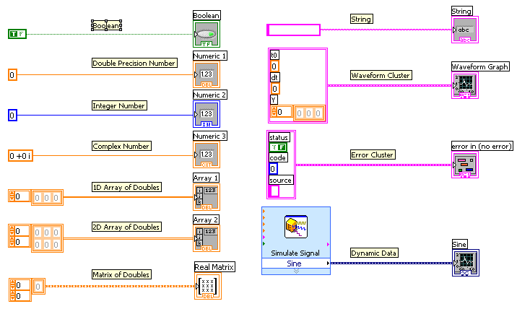
Data Types Found in LabVIEW
Notes:
LabVIEW uses many common data types, including Boolean, numeric, arrays, strings, and clusters.
The color and symbol of each terminal indicate the data type of the control or indicator. Control terminals have a thicker border than indicator terminals. Also, arrows appear on front panel terminals to indicate whether the terminal is a control or an indicator. An arrow appears on the right if the terminal is a control and on the left if the terminal is an indicator.
Definitions
Array: Arrays group data elements of the same type. An array consists of elements and dimensions. Elements are the data that make up the array, and a dimension is the length, height, or depth of an array. An array can have one or more dimensions and as many as (2³¹) – 1 elements per dimension, memory permitting.
Cluster: Clusters group data elements of mixed types, such as a bundle of wires in a telephone cable, where each wire in the cable represents a different element of the cluster.
See Help»Search the LabVIEW Help… for more information. The LabVIEW User Manual on ni.com provides additional references for data types found in LabVIEW.
© National Instruments Corporation 69 Introduction to LabVIEW Hands-On

Slide 26
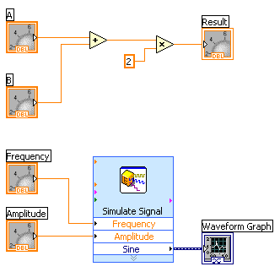
Dataflow Programming
Block diagram execution
Dependent on the flow of data
Block diagram does NOT execute left to right
Node executes when data is available to ALL input terminals
Nodes supply data to all output terminals when done
Notes:
LabVIEW follows a dataflow model for running VIs. A block diagram node executes when all its inputs are available. When a node completes execution, it supplies data to its output terminals and passes the output data to the next node in the dataflow path. Visual Basic, C++, JAVA, and most other text-based programming languages follow a control flow model of program execution. In control flow, the sequential order of program elements determines the execution order of a program.
Consider the block diagram above. It adds two numbers and then multiplies by 2 from the result of the addition. In this case, the block diagram executes from left to right, not because the objects are placed in that order but because one of the inputs of the Multiply function is not valid until the Add function has finished executing and passed the data to the Multiply function. Remember that a node executes only when data are available at all of its input terminals, and it supplies data to its output terminals only when it finishes execution. In the second piece of code, the Simulate Signal Express VI receives input from the controls and passes its result to the graph.
You may consider the add-multiply and the simulate signal code to coexist on the same block diagram in parallel. This means that they begin executing at the same time and run independently of one another. If the computer running this code had multiple processors, these two pieces of code could run independently of one another (each on its own processor) without any additional coding.
Introduction to LabVIEW Hands-On 26 ni.com

Slide 27
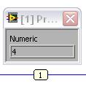
Debugging Techniques
Finding Errors
Execution Highlighting
Probes
Click on broken Run button.
Window showing error appears.
Click on Execution Highlighting button; data flow is animated using bubbles. Values are
displayed on wires.
Right-click on wire to display probe; it shows data as it flows through wire segment.
You can also select Probe tool from Tools palette and click on wire.
Notes:
When your VI is not executable, a broken arrow is displayed in the Run button in the palette.
Finding Errors: To list errors, click on the broken arrow. To locate the bad object, click on the error message.
Execution Highlighting: Animates the diagram and traces the flow of the data, allowing you to view intermediate values. Click on the light bulb on the toolbar.
Probe: Used to view values in arrays and clusters. Click on wires with the Probe tool or right-click on the wire to set probes.
Retain Wire Values: Used with probes to view the values from the last iteration of the program.
Breakpoint: Sets pauses at different locations on the diagram. Click on wires or objects with the Breakpoint tool to set breakpoints.
© National Instruments Corporation 27 Introduction to LabVIEW Hands-On

Slide 28
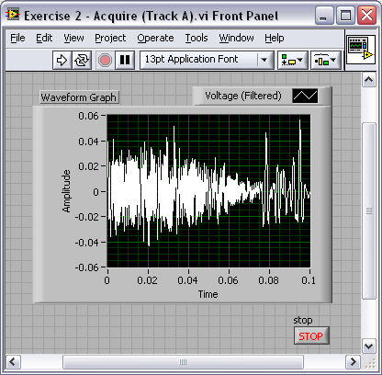
Exercise 2 – Acquiring a Signal with DAQ
Use a LabVIEW template to:
Acquire a signal from your DAQ device
This exercise should take 15 minutes.
Track A&B
Notes:
Exercise 1.2 – Acquiring a Signal with DAQ (Track A)
Complete the following steps to create a VI that acquires data continuously from your
DAQ device.
Launch LabVIEW.
2. In the Getting Started window, click the File»New or More … link to display the New dialog box.
3. Open a data acquisition template. From the Create New list, select VI»From Template»DAQ»Data Acquisition with NI-DAQmx.vi and click “OK.”
4. Display the block diagram by clicking it or by selecting Window»Show Block Diagram. Read the instructions written there about how to complete the program.
5. Double-click the DAQ Assistant to launch the configuration wizard.
Configure an analog input operation.
a. Choose Acquire Signals»Analog Input»Voltage.
b. Choose Dev1 (USB-6009)»ai0 to acquire data on analog input channel 0 and click “Finish.”
c. In the next window, define the parameters of your analog input operation. To choose an input range that works well with your microphone, on the settings tab enter 2 V for the maximum and –2 V for the minimum. Under timing settings choose “Continuous” for the acquisition mode and enter 10000 for the rate. Leave all other choices set to their default values. Click “OK” to exit the wizard.
Place the Filter Express VI to the right of the DAQ Assistant on the block diagram. From the Functions palette, select Express»Signal Analysis»Filter and place it on the block diagram inside the while loop. When you bring up the Functions palette, press the small pushpin in the upper left-hand corner of the palette. This tacks down the palette so that it doesn’t disappear. This step is omitted in the following exercises, but you should repeat it. In the configuration window under Filtering Type, choose “Highpass.” Under Cutoff Frequency, use a value of 300 Hz. Click “OK.”
Introduction to LabVIEW Hands-On 28 ni.com

Slide 29
Do Not Delete Exercise Instructions
Notes:
Make the following connections on the block diagram by hovering your mouse over the terminal so that it becomes the wiring tool and clicking once on each of the terminals you wish to connect:
a. Connect the “Data” output terminal of the DAQ Assistant VI to the “Signal” input of the Filter VI.
b. Create a graph indicator for the filtered signal by right-clicking on the “Filtered Signal” output terminal and choosing Create»Graph Indicator.
Return to the front panel by selecting Window»Show Front Panel or by pressing <Ctrl-E>.
Run your program by clicking the run button. Hum or whistle into the microphone to observe the changing voltage on the graph.
Click Stop once you are finished.
Save the VI as “Exercise 2 – Acquire.vi” in your Exercises folder and close it.
Note: The solution to this exercise is printed in the back of this manual.
Tip: You can place the DAQ Assistant on your block diagram from the Functions palette. Right-click the block diagram to open the Functions palette and go to Express»Input to find it.
(End of Exercise)
© National Instruments Corporation 29 Introduction to LabVIEW Hands-On

Slide 30
Do Not Delete Exercise Instructions
Notes:
Exercise 1.2 – Acquiring a Signal with DAQ (Track B)
Complete the following steps to create a VI that acquires data continuously from your
simulated DAQ device.
Launch LabVIEW.
2. In the Getting Started window, click the File»New or More … link to display the New dialog box.
3. Open a data acquisition template. From the Create New list, select VI»From Template»DAQ»Data Acquisition with NI-DAQmx.vi and click “OK.”
4. Display the block diagram by clicking it or by selecting Window»Show Block Diagram. Read the instructions written there about how to complete the program.
5. Double-click the DAQ Assistant to launch the configuration wizard.
Configure an analog input operation.
a. Choose Acquire Signals»Analog Input»Voltage.
b. Choose Dev1 (PCI-6220)»ai0 to acquire data on analog input channel 0 and click “Finish.”
c. In the next window, define the parameters of your analog input operation. On the task timing tab, choose “Continuous” for the acquisition mode, enter 10000 for samples to read, and 10000 for the rate. Leave all the other choices set to their default values. Click “OK” to exit the wizard.
Create a graph indicator for the signal by right-clicking on the “Data” output on the DAQ Assistant and choosing Create»Graph Indicator.
Return to the front panel by selecting Window»Show Front Panel or by pressing <Ctrl-E>.
Run your program by clicking the run button. Observe the simulated sine wave on the graph.
Click Stop once you are finished.
Save the VI as “Exercise 2 – Acquire.vi” in the Exercises folder. Close the VI.
Notes:
The solution to this exercise is printed in the back of this manual.
You can place the DAQ Assistant on your block diagram from the Functions palette. Right-click the block diagram to open the Functions palette and go to Express»Input to find it. When you bring up the Functions palette, press the small pushpin in the upper left-hand corner of the palette. This tacks down the palette so that it doesn’t disappear. This step is omitted in the following exercises, but you should repeat it.
Introduction to LabVIEW Hands-On 30 ni.com

Slide 31
Do Not Delete Exercise Instructions
Notes:
(End of Exercise)
© National Instruments Corporation 31 Introduction to LabVIEW Hands-On

Slide 32
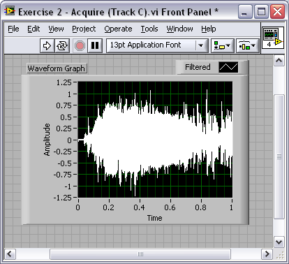
Exercise 2 – Acquiring a Signal with the Sound Card
Use LabVIEW to:
Acquire a signal from your sound card
This exercise should take 15 minutes.
Track C
Notes:
Exercise 1.2 – Acquiring a Signal with the Sound Card (Track C)
Complete the following steps to create a VI that acquires data from your sound card.
Launch LabVIEW.
In the Getting Started window, click the Blank VI link.
Display the block diagram by pressing <Ctrl+E> or selecting Window»Show Block Diagram.
Place the Acquire Sound Express VI on the block diagram. Right-click to open the functions palette and select Express»Input»Acquire Sound. Place the Express VI on the block diagram.
In the configuration window under #Channels, select 1 from the pull-down list. Under Duration(s), use a value of 5 seconds. Click “OK.”
Place the Filter Express VI to the right of the Acquire Signal VI on the block diagram. From the functions palette, select Express»Signal Analysis»Filter and place it on the block diagram. In the configuration window under Filtering Type, choose “Highpass.” Under Cutoff Frequency, use a value of 300 Hz. Click “OK.”
Make the following connections on the block diagram by hovering your mouse over the terminal so that it becomes the wiring tool and clicking once on each of the terminals you wish to connect:
a. Connect the “Data” output terminal of the Acquire Sound VI to the “Signal” input of the Filter VI.
b. Create a graph indicator for the filtered signal by right-clicking on the “Filtered Signal” output terminal and choose Create»Graph Indicator.
Return to the front panel by pressing <Ctrl+E> or Window»Show Front Panel.
Run your program by clicking Run button. Hum or whistle into your microphone and observe the data you acquire from your sound card.
Save the VI as “Exercise 2 – Acquire.vi” in the Exercises folder.
Close the VI.
Note: The solution to this exercise is printed in the back of this manual.
(End of Exercise)
Introduction to LabVIEW Hands-On 32 ni.com

Slide 33
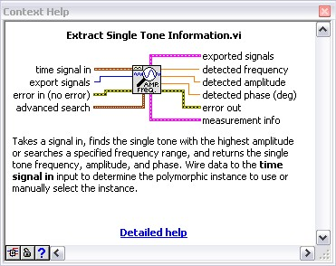
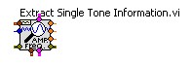
Context Help Window
Help»Show Context Help, press the <Ctrl+H> keys
Hover cursor over object to update window
Additional Help
Right-click on the VI icon and choose Help, or
Choose “Detailed help” on the context help window
Notes:
The Context help window displays basic information about LabVIEW objects when you move the cursor over each object. Objects with context help information include VIs, functions, constants, structures, palettes, properties, methods, events, and dialog box components.
To display the Context help window, select Help»Show Context Help, press the <Ctrl+H> keys, or press the Show Context Help Window button in the toolbar
Connections displayed in Context Help:
Required – bold Recommended – normal Optional – dimmed
Additional Help
VI, Function, & How-To Help is also available.
Help»VI, Function, & How-To Help
Right-click the VI icon and choose Help, or
Choose “Detailed Help” on the Context help window.
LabVIEW Help – reference style help
Help»Search the LabVIEW Help…
© National Instruments Corporation 33 Introduction to LabVIEW Hands-On

Slide 34
Tips for Working in LabVIEW
Keystroke Shortcuts
<Ctrl+H> – Activate/Deactivate Context Help Window
<Ctrl+B> – Remove Broken Wires from Block Diagram
<Ctrl+E> – Toggle between Front Panel and Block Diagram
<Ctrl+Z> – Undo (also in Edit menu)
Tools»Options… – Set Preferences in LabVIEW
File»VI Properties – Configure VI Appearance, Documentation, and so on
Notes:
LabVIEW has many keystroke shortcuts that make working easier. The most common shortcuts are listed above.
While the Automatic Selection Tool is great for choosing the tool you would like to use in LabVIEW, there are sometimes cases when you want manual control. Once the Automatic Selection Tool is turned off, use the Tab key to toggle between the four most common tools (Operate Value, Position/Size/Select, Edit Text, Set Color on front panel and Operate Value, Position/Size/Select, Edit Text, Connect Wire on block diagram). Once you are finished with the tool you chose, you can press <Shift+Tab> to turn the Automatic Selection Tool back on.
In the Tools»Options… dialog, there are many configurable options for customizing your front panel, block diagram, colors, printing, and so on.
Similar to the LabVIEW options, you can configure VI-specific properties by going to File»VI Properties… There you can document the VI, change the appearance of the window, and customize it in several other ways.
Introduction to LabVIEW Hands-On 34 ni.com

Slide 35
Section II – Elements of Typical Programs
A. Loops
While Loop
For Loop
B. Functions and SubVIs
Types of Functions
Creating Custom Functions (subVI)
Functions Palette and Searching
C. Decision Making and File I/O
Case Structure
Select (simple If statement)
File I/O
Notes:
© National Instruments Corporation 35 Introduction to LabVIEW Hands-On

Slide 36
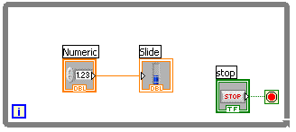
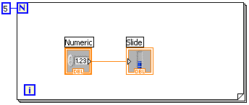
Loops
While Loop
While Loop
Terminal counts iterations
Always runs at least once
Runs until stop condition is met
For Loop
For Loop
Terminal counts iterations
Runs according to input N of count terminal
Notes:
Both the while and for loops are located on the Functions»Structures palette. The for loop differs from the while loop in that the for loop executes a set number of times. A while loop stops executing the subdiagram only if the value at the conditional terminal exists.
While Loops
Similar to a do loop or a repeat-until loop in text-based programming languages, a while loop, shown at the top right, executes a subdiagram until a condition is met. The while loop executes the sub diagram until the conditional terminal, an input terminal, receives a specific Boolean value. The default behavior and appearance of the conditional terminal is Stop If True. When a conditional terminal is Stop If True, the while loop executes its subdiagram until the conditional terminal receives a TRUE value. The iteration terminal (an output terminal), shown at left, contains the number of completed iterations. The iteration count always starts at zero. During the first iteration, the iteration terminal returns 0.
For Loops
A for loop, shown above, executes a subdiagram a set number of times. The value in the count terminal (an input terminal) represented by the N, indicates how many times to repeat the subdiagram. The iteration terminal (an output terminal), shown at left, contains the number of completed iterations. The iteration count always starts at zero. During the first iteration, the iteration terminal returns 0.
Introduction to LabVIEW Hands-On 36 ni.com

Slide 37
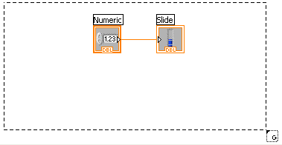
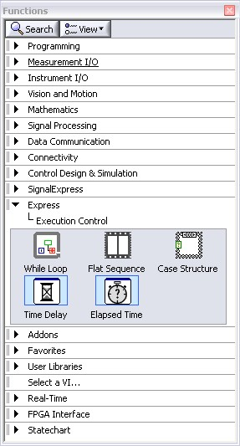
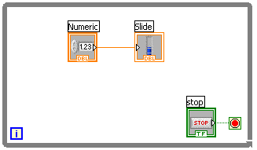
Drawing a Loop
2. Enclose code to be repeated
1. Select the structure
3. Drop or drag additional nodes and then wire
Notes:
Place loops in your diagram by selecting them from the Functions palette:
When selected, the mouse cursor becomes a special pointer that you use to enclose the section of code you want to include in the while loop.
Click the mouse button to define the top-left corner and then click the mouse button again at the bottom-right corner. The while loop boundary appears around the selected code.
Drag or drop additional nodes in the While Loop if needed.
© National Instruments Corporation 37 Introduction to LabVIEW Hands-On

Slide 38
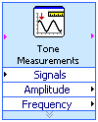
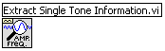

3 Types of Functions (from the Functions Palette)
Express VIs: interactive VIs with configurable dialog page (blue border)
Standard VIs: modularized VIs customized by wiring (customizable)
Functions: fundamental operating elements of LabVIEW; no front panel or block diagram (yellow)
Notes:
LabVIEW 7.0 introduced a new type of subVI called Express VIs. These are interactive VIs that have a configuration dialog box that helps the user customize the functionality of the Express VI. LabVIEW then generates a subVI based on these settings.
SubVIs are VIs (consisting of a front panel and a block diagram) that are used within another VI.
Functions are the building blocks of all VIs. Functions do not have a front panel or a block diagram.
Introduction to LabVIEW Hands-On 38 ni.com

Slide 39
What Types of Functions Are Available?
Input and Output
Signal and data simulation
Real signal acquisition and generation with DAQ
Instrument I/O Assistant (Serial and GPIB)
ActiveX for communication with other programs
Analysis
Signal processing
Statistics
Advanced math and formulas
Continuous time solver
Storage
File I/O
Express Functions Palette
Notes:
LabVIEW includes several hundred prebuilt functions to help you acquire, analyze, and present data. You would generally use these functions as outlined on the slide above.
LabVIEW Toolkits
Additional toolkits are available for adding domain-specific functionality to LabVIEW. These toolkits include:
ni.com/toolkits
© National Instruments Corporation 39 Introduction to LabVIEW Hands-On

Slide 40
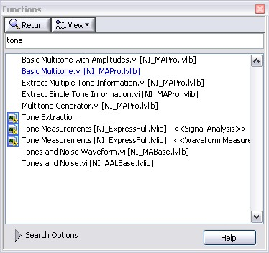
Searching for Controls, VIs, and Functions
Palettes are filled with hundreds of VIs
Press the search button to index all VIs for text searching
Click and drag an item from the search window to the block diagram
Double-click an item to open the owning palette
Notes:
Use the buttons on top of the palette windows to navigate, search, and edit the palettes.
You can search for controls, VIs, and functions that either contain certain words or start with certain words. Double-clicking a search result opens the palette that contains the search result. You also can click and drag the name of the control, VI, or function directly to the front panel or block diagram.
Introduction to LabVIEW Hands-On 40 ni.com

Slide 41
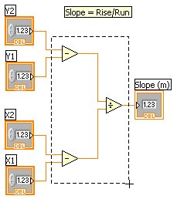
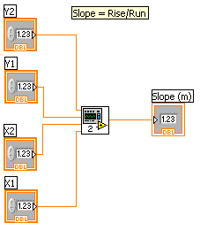
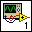
Create SubVI
Enclose area to be converted into a subVI
Select Edit»Create SubVI from the Edit menu
Notes:
Creating SubVIs
After you build a VI, you can use it in another VI. A VI called from the block diagram of another VI is called a subVI. You can reuse a subVI in other VIs. To create a subVI, you need to build a connector pane and create an icon.
A subVI node corresponds to a subroutine call in text-based programming languages. A block diagram that contains several identical subVI nodes calls the same subVI several times.
The subVI controls and indicators receive data from and return data to the block diagram of the calling VI. Click the Select a VI icon or text on the Functions palette, navigate to and double-click a VI, and place the VI on a block diagram to create a subVI call to that VI.
You can easily customize subVI input and output terminals as well as the icon. Follow the instructions below to quickly create a subVI.
Creating SubVIs from Sections of a VI
Convert a section of a VI into a subVI by using the Positioning tool to select the section of the block diagram you want to reuse and selecting Edit»Create SubVI. An icon for the new subVI replaces the selected section of the block diagram. LabVIEW creates controls and indicators for the new subVI, automatically configures the connector pane based on the number of control and indicator terminals you selected, and wires the subVI to the existing wires.
See Help»Search the LabVIEW Help…»SubVIs for more information.
© National Instruments Corporation 41 Introduction to LabVIEW Hands-On

Slide 42
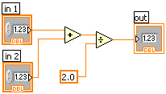
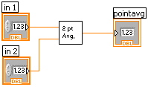
LabVIEW Functions and SubVIs Operate Like Functions in Other Languages
Function Pseudo Code
function average (in1, in2, out)
{
out = (in1 + in2)/2.0;
}
SubVI Block Diagram
Calling Program Pseudo Code
main
{
average (in1, in2, pointavg)
}
Calling VI Block Diagram
Notes:
A subVI node corresponds to a subroutine call in text-based programming languages. The node is not the subVI itself, just as a subroutine call statement in a program is not the subroutine itself. A block diagram that contains several identical subVI nodes calls the same subVI several times.
The modular approach makes applications easier to debug and maintain.
The functionality of the subVI does not matter for this example. The important point is the passing of two numeric inputs and one numeric output.
Introduction to LabVIEW Hands-On 42 ni.com

Slide 43
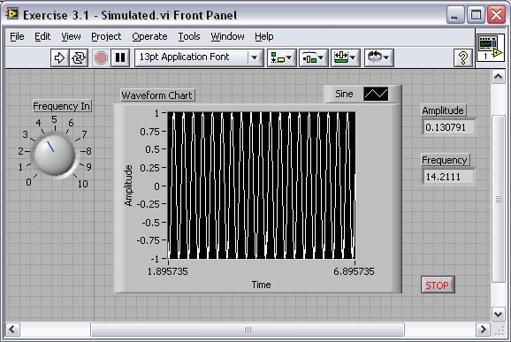
Exercise 3.1 – Analysis
Use LabVIEW Express VIs to:
Simulate a signal and display its amplitude and frequency
This exercise should take 15 minutes.
Track A,B,&C
Notes:
Exercise 2.1 – Analysis (Tracks A, B, and C)
Create a VI that produces a sine wave with a specified frequency and displays the data on a waveform chart until stopped by the user.
Open a blank VI from the Getting Started screen.
Place a chart on the front panel. Right-click to open the Controls palette and select Controls»Modern»Graph»Waveform Chart.
Place a dial control on the front panel. From the Controls palette, select Controls»Modern »Numeric»Dial. Notice that when you first place the control on the front panel, the label text is highlighted. While this text is highlighted, type “Frequency In” to give a name to this control.
Go to the block diagram (<Ctrl+E>) and place a while loop down. Right-click to open the Functions palette and select Express»Execution Control»While Loop. Click and drag on the block diagram to make the while loop the correct size. Select the waveform chart and dial and drag them inside the while loop if they are not already. Notice that a stop button is already connected to the conditional terminal of the while loop.
Place the Simulate Signal Express VI on the block diagram. From the Functions palette, select Express»Signal Analysis»Simulate Signal and place it on the block diagram inside the while loop. In the configuration window under Timing, choose “Simulate acquisition timing.” Click “OK.”
6. Place a Tone Measurements Express VI on the block diagram (Express»Signal Analysis»Tone). In the configuration window, choose Amplitude and Frequency measurements in the Single Tone Measurements section. Click “OK.”
© National Instruments Corporation 43 Introduction to LabVIEW Hands-On

Slide 44
Do Not Delete Exercise Instructions
Notes:
7. Make the following connections on the block diagram by hovering your mouse over the terminal so that it becomes the wiring tool and clicking once on each of the terminals you wish to connect:
a. Connect the “Sine” output terminal of the Simulate Signal VI to the
“Signals” input of the Tone Measurements VI.
b. Connect the “Sine” output to the waveform chart.
c. Create indicators for the amplitude and frequency measurements by right- clicking on each of the terminals of the Tone Measurements Express VI and selecting Create»Numeric Indicator.
d. Connect the “Frequency In” control to the “Frequency” terminal of the
Simulate Signal VI.
8. Return to the front panel and run the VI. Move the “Frequency In” dial and observe the frequency of the signal. Click the Stop button once you are finished.
Save the VI as “Exercise 3.1 – Simulated.vi”.
Close the VI.
Notes
When you bring up the Functions palette, press the small pushpin in the upper left-hand corner of the palette. This tacks down the palette so that it doesn’t disappear. This step is omitted in the following exercises, but you should repeat it.
The solution to this exercise is printed in the back of this manual.
(End of Exercise)
Introduction to LabVIEW Hands-On 44 ni.com

Slide 45
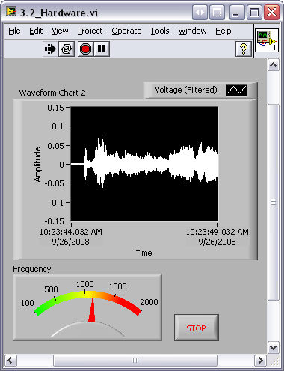
Exercise 3.2 – Analysis
Use LabVIEW Express VIs to:
Acquire a signal and display its amplitude and frequency
This exercise should take 15 minutes.
Track A
Notes:
Exercise 2.2 – Analysis (Track A)
Create a VI that measures the frequency of a filtered signal from your USB-6009 DAQ device and displays the acquired signal on a waveform chart. The instructions are similar to Exercise 3.1, but you use DAQ Assistant in place of the Simulate Signal VI and you use Filter Express VI. Try to do this without following the instructions.
Open a blank VI.
Place a waveform chart on the front panel. Right-click to open the Controls palette and select Controls»Modern»Graph»Waveform Chart.
Place a numeric meter on the front panel. The meter is found in Controls»Moden»Numeric»Meter.
Right-click the y-axis on the waveform chart and deselect “AutoScale Y.”
Change the scale on the y-axis to -0.15 to 0.15 v by double-clicking the maximum and minimum axis values and typing the new value. Change the scale of the meter to 100 to 2000.
Go to the block diagram and place a while loop around the chart and the meter (Express»Execution Control»While Loop).
Place the DAQ Assistant on the block diagram (Express»Input»DAQ Assistant). Choose analog input on channel ai0 of your device and click “Finish.” On the Task Timing tab, choose “continuous” for the acquisition mode. If you are using the USB-6009, change the Input Range to -2 to 2, the number of Samples to Read to 1000, and the Rate (Hz) to 44100.
Place the Filter Express VI to the right of the DAQ Assistant on the block diagram. From the Functions palette, select Express»Signal Analysis»Filter and place it on the block diagram inside the while loop. In the configuration window under Filtering Type, choose “Highpass.” Under Cutoff Frequency, use a value of 300 Hz. Click “OK.”
Connect the “Data” output terminal of the DAQ Assistant to the “Signal” input of the Filter VI.
Connect the waveform chart to the “Filtered Signal” output.
Place a Tone Measurements Express VI on the block diagram (Express»Signal Analysis»Tone). Select “Frequency” under Single Tone Measurements.
Connect the output of the Filter VI to the “Signals” input of the Tone Measurements Express VI. Also, connect the “Frequency” output to the meter.
Return to the front panel and run the VI. Observe your acquired signal and its frequency and amplitude. Hum or whistle into the microphone and observe the frequency that you are producing.
Save the VI as “Exercise 3.2 - Data.vi.”
Close the VI.
Note: The solution to this exercise is printed in the back of this manual.
(End of Exercise)
© National Instruments Corporation 45 Introduction to LabVIEW Hands-On

Slide 46

Exercise 3.2 – Analysis
Use LabVIEW Express VIs to:
Acquire a signal and display its amplitude and frequency
This exercise should take 15 minutes.
Track B
Notes:
Exercise 2.2 – Analysis (Track B)
Create a VI that measures the frequency of a filtered simulated signal and shows the difference between the filtered and unfiltered signal. You have to simulate the noise in the Simulate Signal Express VI. Try to do this without following the instructions.
Open a blank VI.
Place two waveform charts on the front panel. Right-click to open the Controls palette and select Controls»Modern»Graph»Waveform Chart.
Place a numeric meter on the front panel. The Meter is found in Controls»Modern»Numeric»Meter.
Right-click the y-axis on each waveform chart and deselect “AutoScale Y.”
Change the scale on the y-axis on both charts to -1 to 1 v by double-clicking the maximum and minimum axis values and typing the new value. Change the scale of the meter to 0 to 30.
Go to the block diagram and place a while loop around the charts and the meters (Express»Execution Control»While Loop).
Place a Simulate Signal Express VI on the block diagram (Express»Input»Simulate Sig). Change the Frequency (Hz) to 20, Select to add noise, and set the Samples per Second (Hz) to 10000.
Ensure that the Noise Type is “Uniform White Noise” and the Noise Amplitude is “0.2.”
Place the Filter Express VI to the right of the DAQ Assistant on the block diagram. From the Functions palette, select Express»Signal Analysis»Filter and place it on the block diagram inside the while loop. In the configuration window under Filtering Type, choose “Lowpass.” Under Cutoff Frequency, use a value of 35 Hz. Click “OK.”
Connect the output terminal of the Simulate Signal VI to the “Signal” input of the Filter VI. Connect the waveform charts to the “Filtered Signal” output and the output of the Simulate Signal VI.
Place a Tone Measurements Express VI on the block diagram (Express»Signal Analysis»Tone). Select “Frequency” under Single Tone Measurements.
Connect the output of the Filter VI to the “Signals” input of the Tone Measurements Express VI. Also, connect the “Frequency” output to the meter.
Return to the front panel and run the VI. Observe your acquired signal and its frequency and amplitude. Hum or whistle into the microphone and observe the frequency that you are producing.
Save the VI as “Exercise 3.2 - Data.vi.”
Close the VI.
Note: The solution to this exercise is printed in the back of this manual.
(End of Exercise)
Introduction to LabVIEW Hands-On 46 ni.com

Slide 47

Exercise 3.2 – Analysis
Use LabVIEW Express VIs to:
Acquire a signal and display its amplitude and frequency
This exercise should take 15 minutes.
Track C
Notes:
Exercise 2.2 – Analysis (Track C)
Create a VI that measures the frequency of the signal from your sound card and displays the acquired signal on a waveform chart. The instructions are similar to Exercise 3.1, but you use the Acquire Sound Signal VI in place of the Simulate Signal VI and a Filter Express VI. Try to do this without following the instructions.
Open a blank VI.
Place a waveform chart on the front panel. Right-click to open the Controls palette and select Controls»Modern»Graph»Waveform Chart.
Place a numeric meter on the front panel. The meter is found in Controls»Numeric»Meter.
Right-click the y-axis on the waveform chart and deselect “AutoScale Y.”
Change the scale on the Y-Axis to -1 to 1 v by double-clicking the maximum and minimum axis values and typing the new value. Change the scale of the meter to 100 to 2000.
Go to the block diagram and place a while loop down (Express»Execution Control»While Loop).
Place the Acquire Sound Express VI on the block diagram (Express»Input»Acquire Sound).
Change the sample rate to 44100 and Click “OK.”
Place a Filter Express VI on the block diagram. In the configuration window, choose a highpass filter and a cutoff frequency of 300 Hz.
Place a Tone Measurements Express VI on the block diagram (Express»Signal Analysis»Tone). In the configuration window, choose “Amplitude” and “Frequency” measurements in the Single Tone Measurements section.
Connect the meter to the “Frequency” output of the Tone Measurements VI.
Connect the “Data” terminal of the Acquire Sound Express VI to the “Signal” input of the Filter VI.
Connect the “Filtered Signal” terminal of the Filter VI to the “Signals” input of the Tone Measurements VI. Select “Frequency” under Single Tone Measurements.
Return to the front panel and run the VI. Observe the signal from your sound card and its amplitude and frequency. Hum or whistle into the microphone and observe the amplitude and frequency you are producing.
Save the VI as “Exercise 3.2-Data.vi.” Close the VI.
Note: The solution to this exercise is printed in the back of this manual.
(End of Exercise)
© National Instruments Corporation 47 Introduction to LabVIEW Hands-On

Slide 48


How Do I Make Decisions in LabVIEW?
Case Structures
Select
(a)
(b)
(c)
Notes:
Case Structure
The case structure has one or more subdiagrams, or cases, one of which executes when the structure executes. The value wired to the selector terminal determines which case to execute and can be Boolean, string, integer, or enumerated type. Right-click the structure border to add or delete cases. Use the Labeling tool to enter value(s) in the case selector label and configure the value(s) handled by each case. It is found at Functions»Programming»Structures»Case Structure.
Select
Returns the value wired to the t input or f input, depending on the value of s. If s is TRUE, this function returns the value wired to t. If s is FALSE, this function returns the value wired to f. The connector pane displays the default data types for this polymorphic function. It is found at Functions»Programming» Comparison»Select.
Example A: Boolean input - Simple if-then case. If the Boolean input is TRUE, the true case executes; otherwise the FALSE case executes.
Example B: Numeric input. The input value determines which box to execute. If out of range of the cases, LabVIEW chooses the default case.
Example C: When the Boolean passes a TRUE value to the Select VI, the value 5 is passed to the indicator. When the Boolean passes a FALSE value to the Select VI, 0 is passed to the indicator.
Introduction to LabVIEW Hands-On 48 ni.com

Slide 49


File I/O
File I/O – passing data to and from files
Files can be binary, text, or spreadsheet
Write/Read LabVIEW Measurements file (*.lvm)
Writing to *.lvm file
Reading from *.lvm file
Notes:
Use LabVIEW measurement data files to save data that the Write Measurement File Express VI generates. The LabVIEW data file is a tab-delimited text file you can open with a spreadsheet application or a text-editing application. In addition to the data an Express VI generates, the .lvm file includes information about the data, such as the date and time the data was generated.
File I/O operations pass data from memory to and from files. In LabVIEW, you can use File I/O functions to:
Open and close data files
Read data from and write data to files
Read from and write to spreadsheet-formatted files
Move and rename files and directories
Change file characteristics
Create, modify, and read a configuration file
Write to or read from LabVIEW measurement files
In the next example, examine how to write to or read from LabVIEW measurement files (*.lvm files).
© National Instruments Corporation 49 Introduction to LabVIEW Hands-On

Slide 50
High-Level File I/O Functions
Easy to use
High level of abstraction
Writing to LVM file
Reading from LVM file
Notes:
High-Level File I/O: These functions provide a higher level of abstraction to the user by opening and closing the file automatically before and after reading or writing data. Some of these functions are:
Write To Spreadsheet File – Converts a 1D or 2D array of strings, signed integers, or double-precision numbers to a text string and writes the string to a new byte stream file or appends the string to an existing file.
Read From Spreadsheet File – Reads a specified number of lines or rows from a numeric text file beginning at a specified character offset and converts the data to a 2D double-precision array of numbers, strings, or integers. You must manually select the polymorphic instance you want to use. The VI opens the file before reading from it and closes it afterward.
Write To Measurement File – Express VI that writes data to a text-based measurement file (.lvm) or a binary measurement file (.tdm or .tdms).
Read From Measurement File – An Express VI that reads data from a text-based measurement file (.lvm) or a binary measurement file (.tdm or .tdms) format. You can specify the file name, file format, and segment size.
These functions are easy to use and excellent for simple applications. In the case where you need to constantly stream to the files by continuously writing to or reading from the file, you may experience some overhead in using these functions.
© National Instruments Corporation 50 Introduction to LabVIEW Hands-On

Slide 51

Exercise 3.3 – Decision Making and Saving Data
Use a case structure to:
Make a VI that saves data when a condition is met
This exercise should take 15 minutes.
Track A,B,C
Notes:
Exercise 2.3 – Decision Making and Saving Data (Tracks A, B, and C)
Create a VI that you can use to save your data to file if the frequency of your data
goes below a user-controlled limit.
Open Exercise 3.2 – Data.vi.
Go to File»Save As… and save it as “Exercise 3.3 – Decision Making and Saving Data.” In the “Save As” dialog box, make sure substitute copy for original is selected and click “Continue…”
Add a case structure to the block diagram inside the while loop (Functions»Programming»Structures»Case Structure).
Inside the “true” case of the case structure, add a Write to Measurement File Express VI (Functions»Programming»File I/O»Write to Measurement File).
a. In the configuration window that opens, choose “Save to series of files
(multiple files).” Note the default location your file will be saved to and change it if you wish.
b. Click “Settings…” and choose “Use next available file name” under the
Existing Files heading.
c. Under File Termination, choose to start a new file after 10 segments. Click “OK” twice.
Add code so that if the frequency computed from the Tone Measurements Express VI goes below a user-controlled limit, the data will be saved to file. Hint: Go to Functions»Programming»Comparison»Less?
Remember to connect your data from the Filter Express VI to the “Signals” input of the Write to Measurement File VI. If you need help, refer to the solution of this exercise.
Go to the front panel and run your VI. Vary your frequency limit and then stop the VI.
Navigate to My Documents»LabVIEW Data (or the location you specified) and open one of the files that was saved there. Examine the file structure and check to verify that 10 segments are in the file.
Save your VI and close it.
Note: The solution to this exercise is printed in the back of this manual.
(End of Exercise)
Introduction to LabVIEW Hands-On 50 ni.com

Slide 52





File I/O Programming Model – Under the Hood
Open/ Create/ Replace File
Read
and/or Write to File
Close
File
Check for
Errors
Notes:
Programming Model for the Intermediate File VIs
This same programming model applies to data acquisition, instrument control, file I/O, and most other communication schemes. In most instances, you open the file or communication channel, read and write multiple times, and then close or end the communication. It is also good programming practice to check for errors at the end. Remember this programming model when you move on to more advanced programming or look inside DAQ, communication, or file I/O Express VIs.
File I/O VIs and Functions
Use the File I/O VIs and functions to open and close files; read from and write to files; create directories and files you specify in the path control; retrieve directory information; and write strings, numbers, arrays, and clusters to files.
Use the high-level File I/O VIs located on the top row of the palette to perform common I/O operations, such as writing to or reading from various types of data. Acceptable types can include characters or lines in text files, 1D or 2D arrays of single-precision numeric values in spreadsheet text files, 1D or 2D arrays of single-precision numeric values in binary files, or 16-bit signed integers in binary files.
Use low-level File I/O VIs and functions located on the middle row of the palette as well as the Advanced File Functions to control each file I/O operation individually.
Use the principal low-level functions to create or open, write data to, read data from, and close a file. You also can use low-level functions to create directories; move, copy, or delete files; list directory contents; change file characteristics; or manipulate paths.
Refer to NI Developer Zone for more information about choosing a file format.
© National Instruments Corporation 51 Introduction to LabVIEW Hands-On

Slide 53
Section III–Presenting Your Results
A. Displaying Data on the Front Panel
Controls and Indicators
Graphs and Charts
Loop Timing
B. Signal Processing
LabVIEW MathScript
Arrays
Clusters
Waveforms
Notes:
Introduction to LabVIEW Hands-On 52 ni.com

Slide 54
What Types of Controls and Indicators Are Available?
Numeric Data
Number Input and Display
Analog Sliders, Dials, and Gauges
Boolean Data
Buttons and LEDs
Array and Matrix Data
Numeric Display
Chart
Graph
XY Graph
Intensity Graph
3D Graph: Point, Surface, and Model
Decorations
Tab Control
Arrows
Other
Strings and Text Boxes
Picture/Image Display
ActiveX Controls
Express Controls Palette
Notes:
Controls and indicators are front panel items that you can use to interact with your program to provide input and display results. You can access controls and indicators by right-clicking the front panel.
In addition, you obtain additional controls and indicators when you install toolkits and modules.
For example, when you install the control design tools, you can use specialized plots, such as Bode and Nyquist, plots that are not available by default.
© National Instruments Corporation 53 Introduction to LabVIEW Hands-On

Slide 55



Charts – Add 1 Data Point at a Time with History
Waveform chart – special numeric indicator that can display a history of values
Chart updates with each individual point it receives
Controls»Express»Graph Indicators»Chart
Notes:
The waveform chart is a special numeric indicator that displays one or more plots. It is located on the Controls»Modern»Graph palette. Waveform charts can display single or multiple plots. The following front panel shows an example of a multiplot waveform chart.
You can change the minimum and maximum values of either the x-axis or y-axis axis by double-clicking on the value with the labeling tool and typing the new value. Similarly, you can change the label of the axis. You can also right-click the plot legend and change the style, shape, and color of the trace that is displayed on the chart.
Introduction to LabVIEW Hands-On 54 ni.com

Slide 56



Graphs – Display Many Data Points at Once
Waveform graph – special numeric indicator that displays an array of data
Graph updates after all points have been collected
May be used in a loop if VI collects buffers of data
Controls»Express»Graph Indicators»Graph
Notes:
Graphs are very powerful indicators in LabVIEW. You can use these highly customizable tools to concisely display a great deal of information.
With the properties page of the graph, you can display settings for plot types, scale and cursor options, and many other features of the graph. To open the properties page, right-click the graph on the front panel and choose Properties.
You can also create technical-paper-quality graphics with the “export simplified image” function. Right-click the graph and select Data Operations»Export Simplified Image…
© National Instruments Corporation 55 Introduction to LabVIEW Hands-On

Slide 57


Building Arrays with Loops (Auto-Indexing)
Loops can accumulate arrays at their boundaries with auto-indexing
For loops auto-index by default
While loops output only the final value by default
Right-click tunnel and enable/disable auto-indexing
Auto-Indexing Enabled
Wire becomes thicker
1D Array
0 1 2 3 4 5
Auto-Indexing Disabled
Wire remains the same size
5
Only one value (last iteration) is passed out of the loop
Notes:
For loops and while loops can index and accumulate arrays at their boundaries. This is known as auto-indexing.
The indexing point on the boundary is called a tunnel
The for loop is auto-indexing-enabled by default
The while loop is auto-indexing-disabled by default
Examples:
Enable auto-indexing to collect values within the loop and build the array. All values are placed in the array upon exiting the loop.
Disable auto-indexing if you are interested only in the final value.
Introduction to LabVIEW Hands-On 56 ni.com

Slide 58


Creating an Array (Step 1 of 2)
From the Controls»Modern»Array, Matrix, and Cluster subpalette, select the Array icon.
Drop it on the front panel.
Notes:
To create an array control or indicator as shown, select an array on the Controls»Modern»Array, Matrix, and Cluster palette, place it on the front panel, and drag a control or indicator into the array shell. If you attempt to drag an invalid control or indicator such as an XY graph into the array shell, you are unable to drop the control or indicator in the array shell.
You must insert an object in the array shell before you use the array on the block diagram. Otherwise, the array terminal appears black with an empty bracket.
© National Instruments Corporation 57 Introduction to LabVIEW Hands-On

Slide 59


Create an Array (Step 2 of 2)
Place an array shell.
Insert data type into the shell (i.e. numeric control).
Notes:
To add dimensions to an array one at a time, right-click the index display and select Add Dimension from the shortcut menu. You also can use the Positioning tool to resize the index display until you have as many dimensions as you want.
1D Array Viewing a Single Element:
1D Array Viewing Multiple Elements:
2D Array Viewing a Single Element:
2D Array Viewing Multiple Elements:
Introduction to LabVIEW Hands-On 58 ni.com

Slide 60


How Do I Time a Loop?
1. Loop Time Delay
Configure the Time Delay Express VI for seconds to wait each iteration of the loop (works on for and while loops).
2. Timed Loops
Configure special timed while loop for desired dt.
Time Delay
Timed Loop
Notes:
Time Delay
The Time Delay Express VI delays execution by a specified number of seconds. Following the rules of dataflow programming, the while loop does not iterate until all tasks inside of it are complete, thus delaying each iteration of the loop.
Timed Loops
Executes each iteration of the loop at the period you specify. Use the timed loop when you want to develop VIs with multirate timing capabilities, precise timing, feedback on loop execution, timing characteristics that change dynamically, or several levels of execution priority.
Double-click the Input Node or right-click the Input Node and select Configure Timed Loop from the shortcut menu to display the Loop Configuration dialog box, where you can configure the timed loop. The values you enter in the Loop Configuration dialog box appear as options in the Input Node.
Wait Until Next ms Multiple
This function waits until the value of the millisecond timer becomes a multiple of the specified millisecond multiple to help you synchronize activities. You can call this function in a loop to control the loop execution rate. However, it is possible that the first loop period might be short. This function makes asynchronous system calls, but the nodes themselves function synchronously. Therefore, it does not complete execution until the specified time has elapsed. This function can be found at Functions»Programming»Timing»Wait Until Next ms Multiple
© National Instruments Corporation 59 Introduction to LabVIEW Hands-On

Slide 61

Control and Indicator Properties
Properties are characteristics or qualities about an object
Properties can be found by right-clicking on a control or indicator
Properties include:
Size
Color
Plot style
Plot color
Features include:
Cursors
Scaling
Notes:
Properties are all the qualities of a front panel object. With properties, you can set or read such characteristics as foreground and background color, data formatting and precision, visibility, descriptive text, size and location on the front panel, and so on.
Introduction to LabVIEW Hands-On 60 ni.com

Slide 62

Exercise 4.1 – Manual Analysis
Use the cursor legend on a graph to:
Verify your frequency and amplitude measurements
This exercise should take 15 minutes.
Track A,B,&C
Notes:
Exercise 3.1 – Manual Analysis (Tracks A, B, and C)
Create a VI that displays simulated data on a waveform graph and measures the
frequency and amplitude of that data. Use cursors on the graph to verify the
frequency and amplitude measurements.
Open Exercise 3.1 – Simulated.vi.
Save the VI as “Exercise 4.1 – Manual Analysis.vi.”
Go to the block diagram and remove the while loop. Right-click the edge of the loop and choose Remove While Loop so that the code inside the loop does not get deleted.
Delete the stop control.
On the front panel, replace the waveform chart with a waveform graph. Right-click the chart and select Replace»Modern»Graph»Waveform Graph.
Make the cursor legend viewable on the graph. Right-click on the graph and select Visible Items»Cursor Legend.
Change the maximum value of the “Frequency In” dial to 100. Double-click on the maximum value and type “100” once the text is highlighted.
Set a default value for the “Frequency In” dial by setting the dial to the value you would like, right-clicking the dial, and selecting Data Operations»Make Current Value Default.
Run the VI and observe the signal on the waveform graph. If you cannot see the signal, you may need to turn on auto-scaling for the x-axis. Right-click on the graph and select X Scale»AutoScale X.
Change the frequency of the signal. Run the VI again so you can see a few periods on the graph.
Manually measure the frequency and amplitude of the signal on the graph using cursors. Right-click on the graph and select Visible Items »Cursor Legend to show the cursor legend. To add a cursor on the graph, right-click on the cursor pane and choose Create Cursor»Free. Once the cursors are displayed, you can drag them around on the graph and their coordinates appear in the cursor legend.
Remember that the frequency of a signal is the reciprocal of its period (f = 1/T). Does your measurement match the frequency and amplitude indicators from the Tone Measurements VI?
Save your VI and close it.
Note: The solution to this exercise is printed in the back of this manual.
(End of Exercise)
© National Instruments Corporation 61 Introduction to LabVIEW Hands-On

Slide 63
Textual Math in LabVIEW
Integrate existing scripts with LabVIEW for faster development
Use Interactive, easy-to-use, hands-on learning environment
Develop algorithms, explore mathematical concepts, and analyze results using a single environment
Freedom to Choose the most effective syntax, whether graphical or textual within one VI
MATLAB ® is a registered trademark of The MathWorks, Inc.
Notes:
Overview
With the release of LabVIEW 8.6, you have new freedom to choose the most effective syntax for technical computing, whether you are developing algorithms, exploring DSP concepts, or analyzing results. You can instrument your scripts and develop algorithms on the block diagram by interacting with popular third-party math tools such as The MathWorks, Inc. MATLAB® software, Wolfram Mathematica, Maplesoft Maple, MathSoft Mathcad, ITT IDL, and NI Xmath. You can use of these math tools with LabVIEW is achieved in a variety of ways depending on the vendor as listed below:
Native LabVIEW textual math node:
LabVIEW MathScript Node, Formula Node
Communication with vendor software through LabVIEW node:
Xmath node, MATLAB script Node, Maple* Node, IDL* Node
Communication with vendor software through VI Server:
Mathematica* VIs, Mathcad* VIs
In LabVIEW, you can combine the intuitive LabVIEW graphical dataflow programming with LabVIEW MathScript, a math-oriented textual programming language that is generally compatible with popular .m file script language.
*LabVIEW toolkit specific to the math tool must be installed.
Introduction to LabVIEW Hands-On 62 ni.com

Slide 64


Math with the LabVIEW MathScript Node
Implement equations and algorithms textually
Input and output variables created at the border
Generally compatible with popular .m file script language
Terminate statements with a semicolon to disable immediate output
(Functions»Programming» Structures»MathScript)
Prototype your equations in the interactive LabVIEW MathScript Window.
Notes:
The LabVIEW MathScript Node enhances LabVIEW by adding a native text-based language for mathematical algorithm implementation in the graphical programming environment. You can open and use the .m file scripts you’ve written and saved from the LabVIEW MathScript window in the LabVIEW MathScript Node. The .m file scripts you created in other math software generally run as well. With LabVIEW MathScript you can pick the syntax you are most comfortable with to solve the problem. You can instrument equations with the LabVIEW MathScript Node for parameter exploration, simulation, or deployment in a final application.
The LabVIEW MathScript Node
Located in the Programming»Structures subpalette.
Resizable box for entering textual computations directly into block diagrams.
To add variables, right-click and choose Add Input or Add Output.
Name variables as they are used in the formula. (Names are case sensitive.)
You can change the data type of the output by right-clicking the input or output node.
Terminate the statements with a semicolon to suppress output.
Right-click on the node to import and export .m files.
© National Instruments Corporation 63 Introduction to LabVIEW Hands-On

Slide 65

The Interactive LabVIEW MathScript Window
Rapidly develop and test algorithms
Share scripts and variables with the node
View/modify variable content in 1D, 2D, and 3D
Variable
Workspace
Output
Window
View/Modify
Variable Contents
User Commands
.m file Script
(LabVIEW»Tools»MathScript Window)
Notes:
The LabVIEW MathScript window provides an interactive environment where you can prototype equations and make calculations. The MathScript window and MathScript Node share a common syntax and global variables, making the move from prototype to implementation seamless. The data preview pane provides a convenient way to view variable data as numbers, graphically, or audibly (with sound card support).
Help for LabVIEW MathScript
You can access help for the environment using the LabVIEW MathScript interactive environment window. Type Help in the command window for an introduction to LabVIEW MathScript help. Typing Help followed by a function will display help specific to that function.
Features of the interactive MathScript window:
Prototype equations and formulas through the Command Window
Easily access function help by typing Help <function> in the Command Window
Select a variable to display its data in the preview pane and listen to the result
Write, save, load, and run .m files using the Script tab
Share data between the MathScript Node and the MathScript window using global variables
Take advantage of advanced plotting features and image export features
Introduction to LabVIEW Hands-On 64 ni.com

Slide 66

Exercise 3.2 – Using MathScript
Use the MathScript Node and Interactive Window to process the acquired signal (logarithmic decay) in the MathScript and save the script.
This exercise should take 25 minutes.
Track A,B,&C
Notes:
Exercise 3.2 – MathScript (Tracks A, B, and C)
Create a VI that uses the LabVIEW MathScript Node to alter your simulated signal and graph it. Use the interactive LabVIEW MathScript window to view and alter the data and then load the script you have created back into the LabVIEW MathScript Node.
Open Exercise 3.1 – Manual Analysis.vi.
Save the VI as “Exercise 4.2 – MathScript.vi”.
Go to the block diagram and delete the wire connecting the Simulate Signal VI to the Waveform Graph.
Place down a LabVIEW MathScript Node (Programming»Structures»MathScript Node).
Right-click on the left border of the LabVIEW MathScript Node and select Add Input. Name this input “In” by typing while the input node is highlighted black.
Convert the Dynamic Data Type output of the Simulate Signals VI to a 1D array of scalars to input to the LabVIEW MathScript Node. Place a Convert from Dynamic Data Express VI on the block diagram (Express»Signal Manipulation»Convert from Dynamic Data). By default, the VI is configured correctly, so click “OK” in the configuration window.
Wire the “Sine” output of the Simulate Signal VI to the “Dynamic Data” input of the Convert from Dynamic Data VI.
Wire the “Array” output of the Convert from Dynamic Data Express VI to the “In” node on the LabVIEW MathScript Node.
To use the data from the Simulate Signal VI in the interactive LabVIEW MathScript window, declare the input variable as a global variable. Inside the LabVIEW MathScript Node, type “global In;”. Note: Do not forget the “;” or the LabVIEW MathScript Node stops operations immediately.
Return to the front panel and increase the frequency to be between 50 and 100. Run the VI.
Open the interactive LabVIEW MathScript window (Tools»MathScript Window…).
In the MathScript window, you can use the Command Window to enter the command that you wish to compute. In the Command Window, type “global In” and press “Enter.” By doing this, you can see the data passed to the variable “In” on the LabVIEW MathScript Node.
© National Instruments Corporation 65 Introduction to LabVIEW Hands-On

Slide 67
Do Not Delete Exercise Instructions
Notes:
Notice that all declared variables in the script along with their dimensions and type are listed on the Variables tab. To display the graphed data, click once on the variable In and change the pull-down menu below from “Numeric” to “Graph.”
Use the Graph palette to zoom in on your data.
Right-click on “Cursor 1” and choose Bring to Center. What does this do?
Drag the cursor around. The cursor does not move if you select the zoom option.
Right-click on the graph and choose Undock Window. What does this do? Close this new window when you are finished.
Introduction to LabVIEW Hands-On 66 ni.com

Slide 68
Do Not Delete Exercise Instructions
Notes:
Multiply the data by a decreasing exponential function. Follow these steps:
a. Make a 100-element array of data that constitutes a ramp function going
from 0.01 to 5 by typing “Array = [0.01:0.05:5];” in the Command
Window and pressing <Enter>. What type of variable is “Array”?
b. Make an array containing a decreasing exponential. Type
“Exp = 5*exp(-Array);” and press <Enter>.
c. Now multiply the Exp and In arrays by typing
“Out = In.*Exp;” and pressing <Enter>.
d. Look at the graph of the variable “Out”.
Go to the History tab and use <Ctrl-click> to choose the four commands you just entered. Copy those commands using <Ctrl-C>.
On the Script tab, paste the commands into the Script Editor using <Ctrl-V>.
Save your script by clicking “Save” at the bottom of the window. Save it as “myscript.txt.”
Close the LabVIEW MathScript window.
Return to the block diagram of Exercise 4.2 – MathScript. Load the script you just made by right-clicking on the MathScript Node border and selecting Import… Navigate to myscript.txt, select it, and click “OK.”
Right-click on the right border of the MathScript Node and select Add Output. Name this output “Out”.
Right-click on the variable “Out” and select Choose Data Type»1D-Array»DBL 1D. Output data types must be set manually on the MathScript Node.
Wire “Out” to the waveform graph.
Return to the front panel and run the VI.
Does the data look like you expect?
Save and close your VI.
Note: The solution to this exercise is printed in the back of this manual.
(End of Exercise)
© National Instruments Corporation 67 Introduction to LabVIEW Hands-On

Slide 69

Exercise 5 – Apply What You Have Learned
This exercise should take 20 minutes.
Track A,B,&C
Notes:
Exercise 3.3 – Apply What You Have Learned (Tracks A, B, and C)
In this exercise, create a VI that uses what you have learned. Design a VI
that does the following:
Acquire data from your device (or create a simulated signal) and graph it.
Filter that data using the Filter Express VI (Functions»Express»Signal Analysis»Filter). There should be a front panel control for a user-configurable cutoff frequency.
Take a fast Fourier transform to get the frequency information from the filtered data and graph the result. Use the Spectral Measurements Express VI (Functions»Express»Signal Analysis»Spectral).
4. Find the dominant frequency of the filtered data using the Tone Measurements Express VI.
Compare that frequency to a user-inputted limit. If the frequency is over that limit, light up an LED on the front panel. If you have a USB-6009, light up the LED on your hardware using the DAQ Assistant. You need to invert the digital line for the LED to light up when over the limit. You can specify this in the configuration window of the DAQ Assistant or with a “not” Boolean function.
If you get stuck, open up the solution or view it at the end of this manual.
(End of Exercise)
Introduction to LabVIEW Hands-On 68 ni.com

Slide 70
Section IV – Advanced Data flow Topics (Optional)
A. Additional Data Types
Cluster
B. Data flow Constructs
Shift Register
Local Variables
C. Large Application Development
Navigator Window
LabVIEW Projects
Notes:
© National Instruments Corporation 69 Introduction to LabVIEW Hands-On

Slide 71
Introduction to Clusters
Data structure that groups data together
Data may be of different types
Analogous to struct in ANSI C
Elements must be either all controls or all indicators
Thought of as wires bundled into a cable
Order is important
Notes:
Clusters group like or unlike components together. They are equivalent to a record in Pascal or a struct in ANSI C.
Cluster components may be of different data types.
Examples:
Error information - Grouping a Boolean error flag, a numeric error code, and an error source string to specify the exact error.
User information - Grouping a string indicating a user’s name and an ID number specifying the user’s security code.
All elements of a cluster must be either controls or indicators. You cannot have a string control and a Boolean indicator. Think of clusters as grouping individual wires (data objects) together into a cable (cluster).
Introduction to LabVIEW Hands-On 70 ni.com

Slide 72



Creating a Cluster
Select a Cluster shell.
Place objects inside the shell.
Controls»Modern»Array, Matrix & Cluster
Notes:
Create a cluster front panel object by choosing Cluster from the Controls»Modern»Array, Matrix & Cluster palette.
This option gives you a shell (similar to the array shell when creating arrays).
You can size the cluster shell when you drop it.
Right-click inside the shell and add objects of any type.
Note: You can even have a cluster inside of a cluster.
The cluster becomes a control or an indicator cluster based on the first object you place inside the cluster.
You can also create a cluster constant on the block diagram by choosing Cluster Constant from the Cluster palette.
This gives you an empty cluster shell.
You can size the cluster when you drop it.
Put other constants inside the shell.
Note: You cannot place terminals for front panel objects in a cluster constant on the block diagram, nor can you place “special” constants like the Tab or Empty String constant within a block diagram cluster shell.
© National Instruments Corporation 71 Introduction to LabVIEW Hands-On

Slide 73


Cluster Functions
In the Cluster & Variant subpalette of the Programming palette
Can also be accessed by right-clicking the cluster terminal
Bundle
(Terminal labels reflect data type)
Bundle By Name
Notes:
The terms bundle and cluster are closely related in LabVIEW.
Example: You use a bundle function to create a cluster. You use an unbundle function to extract the parts of a cluster.
Bundle - Forms a cluster containing the given objects in the specified order.
Bundle by Name - Updates specific cluster object values (the object must have an owned label).
Unbundle - Splits a cluster into each of its individual elements by data type.
Unbundle by Name - Returns the cluster elements whose names you specify.
Note: You must have an existing cluster wired into the middle terminal of the function to use Bundle By Name.
Introduction to LabVIEW Hands-On 72 ni.com

Slide 74


Using Arrays and Clusters with Graphs
The waveform data type contains 3 pieces of data:
t0 = Start time
dt = Time between samples
Y = Array of Y magnitudes
You can create a waveform cluster in two ways:
Build Waveform (absolute time)
Cluster (relative time)
Notes:
The waveform data type carries the data, start time, and ∆t of a waveform. You can create waveforms using the Build Waveform function. Many of the VIs and functions you use to acquire or analyze waveforms accept and return the waveform data type by default. When you wire a waveform data type to a waveform graph or chart, the graph or chart automatically plots a waveform based on the data, start time, and ∆x of the waveform. When you wire an array of waveform data types to a waveform graph or chart, the graph or chart automatically plots all the waveforms.
Build Waveform
Builds a waveform or modifies an existing waveform with the start time represented as an absolute timestamp. Timestamps are accurate to real-world time and date and are very useful for real-world data recording.
Bundle
Builds a waveform or modifies an existing waveform with a relative timestamp. The input to t₀ is a DBL. By building waveforms using the bundle, you can plot data on the negative x-axis (time).
© National Instruments Corporation 73 Introduction to LabVIEW Hands-On

Slide 75



Property and Invoke Nodes
Create Property and Invoke nodes for a VI element by right-clicking the element and selecting Create»Property Node.
Use the Property Node to get and set object properties.
Invoke object methods with the Invoke Node.
Notes:
The Property and Invoke nodes provide an interface for controlling objects from LabVIEW. The object can be an ActiveX object or a reference to a VI through the VI Server.
You can create Property and Invoke nodes using two methods. The first is to right-click on the object and select Create»Property Node. This is good for setting properties and accessing methods of VI elements within that VI. The second method is to place a Property Node or Invoke Node from the Programming»Application Control menu. This is best for accessing the properties and methods of outside applications and VIs because these nodes can take a reference input. You can expand these nodes to read or write to multiple properties and methods at once.
You can use the Property Node to get and set object properties. For instance, if you need your program to reset a control on your front panel, you can create a property node for that control that accesses the “Value” property (right-click and select Create»Property Node»Value). By doing this, you can either read the value of that control or change that property if you change the Property Node to Write mode.
Use the Invoke Node to invoke methods of an object. These methods can include information about an application or ActiveX control, such as version number, or default actions that the object can perform.
Introduction to LabVIEW Hands-On 77 ni.com

Slide 76
Do Not Delete Exercise Instructions
Notes:
Exercise 4.1 – Understanding Property Nodes with Color (Track A, B, and C)
Open a new blank VI.
Add a gauge to the front panel. Right-click to open the Controls palette and then navigate to Modern»Numeric»Gauge.
Switch to the block diagram and place a while loop around your gauge by selecting Programming»Structures»While Loop.
Right-click the stop terminal in the while loop and go to Create»Control. This makes your stop button.
Inside the while loop, place a random number (0-1). Programming»Numeric»Random Number (0-1).
To the right of the random number (0-1), place a Multiply function. Programming»Numeric»Multiply. Wire the random number to the Multiply function.
Right-click the other terminal of the Multiply function and Create»Constant. Make the constant 10.
To the right of the Multiply function, place a Round To Nearest function. Programming»Numeric»Round To Nearest.
Wire the output of the Multiply function to the input of the Round To Nearest function.
Wire the output of the Round To Nearest function to the gauge indicator.
Place a case structure below the gauge indicator and wire the output of the Round To Nearest function to the conditional terminal of the case structure. Your block diagram should look like the following image.
Change to Case 1 in the case structure. Right-click on the border and select Delete This Case.
Create a Visible property node. Right-click the gauge indicator and Create»Property Node»Visible. Place this property to the left of the case structure.
Introduction to LabVIEW Hands-On 78 ni.com

Slide 77
Do Not Delete Exercise Instructions
Notes:
Right-click the Visible Property Node and select Change All To Write.
Create a Boolean control for the Visible Property Node. Right-click the Visible Property Node and select Create»Control.
Place a BG Color Property Node for the gauge indicator within the case structure. Right-click the gauge indicator and Create»Property Node»Housing Colors»BG Color.
Place a BG Color Property Node for the Visible Boolean control within the case structure. Right-click the Visible Boolean control and Create»Property Node»Label»Text Colors»BG Color.
Right-click both Property nodes and select Change All To Write.
Wire through the error clusters for the Visible, Gauge BG Color, and Visible Text Color Property nodes. Your block diagram should look like the following image.
Add a color box constant within the case structure by navigating to Programming»Dialog & User Interface»Color Box Constant.
Click the color box constant and choose a color then wire the color box constant to the inputs of both Property nodes.
Make duplicate cases for cases 0 through 10 by right-clicking the border and selecting Duplicate Case. Do this until you have cases 0 through 10.
Go through each case and choose a different color for your color box constant.
Add a 250 ms wait within your while loop. Programming»Timing»Wait (ms). Right-click the input of the Wait (ms) function and go to Create»Constant. Make the value of the constant 250.
Add a Simple Error Handler.vi outside your while loop by selecting Programming»Dialog & User Interface»Simple Error Handler.vi. Wire the error cluster through to the Simple Error Handler.vi.
Introduction to LabVIEW Hands-On 79 ni.com

Slide 78
Do Not Delete Exercise Instructions
Notes:
Your finished block diagram should look like the following.
Save the VI and run it. Notice that when you toggle the Visible button, the gauge appears and disappears. Also notice how the color of the gauge changes as each new random number is created.
(End of Exercise)
Introduction to LabVIEW Hands-On 80 ni.com

Slide 79


Modularity in LabVIEW – SubVIs
Convert repeated functions and VIs with a single VI
Notes:
Modularity defines the degree to which your VI is composed of discrete components such that a change to one component has minimal impact on other components. In LabVIEW, these separate components are called subVIs. Creating subVIs from your code increases the readability and reusability of your VIs.
In the upper image, note that the repeated code is allowing the user to choose between temperature scales. Because this portion of the code is identical in both cases, you can create a subVI for it. This makes the code more readable by being less clustered, and it allows you to reuse code easily. The code is far less cluttered now and achieves the exact same functionality. You can easily reuse the temperature scale selection portion of the code in other applications.
You can turn any portion of LabVIEW code into a subVI that can be used by other LabVIEW code.
© National Instruments Corporation 81 Introduction to LabVIEW Hands-On

Slide 80
Create SubVI
Enclose area to be converted into a subVI.
Select Edit»Create SubVI from the Edit menu.
Notes:
Creating SubVIs
A subVI node corresponds to a subroutine call in text-based programming languages. A block diagram that contains several identical subVI nodes calls the same subVI several times.
The subVI controls and indicators receive data from and return data to the block diagram of the calling VI. Click the Select a VI icon or text on the Functions palette, navigate to and double-click a VI, and place the VI on a block diagram to create a subVI call to that VI.
You can easily customize a subVI input and output terminals and the icon. Follow the instructions below to quickly create a subVI.
Creating SubVIs from Sections of a VI
Convert a section of a VI into a subVI by using the Positioning tool to select the section of the block diagram you want to reuse and selecting Edit»Create SubVI. An icon for the new subVI replaces the selected section of the block diagram. LabVIEW creates controls and indicators for the new subVI, automatically configures the connector pane based on the number of control and indicator terminals you selected, and wires the subVI to the existing wires.
See Help»Search the LabVIEW Help…»SubVIs for more information.
Introduction to LabVIEW Hands-On 82 ni.com

Slide 81
LabVIEW Functions and SubVIs operate like Functions in other languages
Function Pseudo Code
function average (in1, in2, out)
{
out = (in1 + in2)/2.0;
}
SubVI Block Diagram
Calling Program Pseudo Code
main
{
average (in1, in2, pointavg)
}
Calling VI Block Diagram
Notes:
A subVI node corresponds to a subroutine call in text-based programming languages. The node is not the subVI itself, just as a subroutine call statement in a program is not the subroutine itself. A block diagram that contains several identical subVI nodes calls the same subVI several times. The modular approach makes applications easier to debug and maintain. The functionality of the subVI does not matter for this example. The important point is the passing of two numeric inputs and one numeric output.
© National Instruments Corporation 79 Introduction to LabVIEW Hands-On

Slide 82



Connector Pane and Icon Viewer
Use this connector pane layout as a standard
Top terminals are usually reserved for file paths and references, such as a file reference
Bottom terminals are usually reserved for error clusters
Notes:
With the connector pane and icon viewer, you can define the data being transferred in and out of the subVI, as well as its appearance in the main LabVIEW code. Every VI displays an icon in the upper-right corner of the front panel and block diagram windows. After you build a VI, build the connector pane and icon so you can use the VI as a subVI.
The icon and connector pane correspond to the function prototype in text-based programming languages. There are many options for the connector pane, but some general standards are specified above. Notably, always reserve the top terminals for references and the bottom terminals for error clusters.
To define a connector pane, right-click the icon in the upper-right corner of the front panel and select Show Connector from the shortcut menu. Each rectangle on the connector pane represents a terminal. Use the terminals to assign inputs and outputs. Select a different pattern by right-clicking the connector pane and selecting Patterns from the shortcut menu.
Introduction to LabVIEW Hands-On 84 ni.com

Slide 83

Icon Viewer – Create an Icon
Create custom icons by right-clicking the icon in the upper-right corner of the front panel or block diagram and selecting Edit Icon or by double-clicking the icon
You also can drag a graphic from anywhere in your file system and drop it on the icon
Refer to the Icon Art Glossary at ni.com for standard graphics to use in a VI icon
Notes:
An icon is a graphical representation of a VI. If you use a VI as a subVI, the icon identifies the subVI on the block diagram of the VI. The Icon Editor is a utility built into LabVIEW you can use to fully customize the appearance of your subVIs. This allows you to visually distinguish your subVIs, which greatly improves the usability of the subVI in large portions of code.
After you’ve defined the connector pane and have customized the icon, you are ready to place the subVI into other LabVIEW code. There are two ways to accomplish this:
To place a subVI on the block diagram:
1. Select the Select a VI… from the Functions palette
2. Navigate to the VI you want to use as a subVI
3. Double-click to place it on the block diagram
To place an open VI on the block diagram of another open VI:
1. Use the Positioning tool to click the icon of the VI you want to use as a subVI
2. Drag the icon to the block diagram of the other VI
© National Instruments Corporation 85 Introduction to LabVIEW Hands-On

Slide 84
Do Not Delete Exercise Instructions
Notes:
Exercise 4.2 – Creating a SubVI
Create a subVI from a new VI, which adds two inputs and outputs the sum.
Open a new VI. From the Getting Started screen, <Ctrl-N> opens a new VI.
Place the Add function on the block diagram. Right-click on the block diagram and navigate to Programming»Numeric»Add.
Create controls and indicators by right-clicking and selecting Create»Control or Indicator. The block diagram and front panel should look similar to the images below.
On the front panel right-click the icon at the top right and select Show Connector to reveal the connector pane.
Assign icon terminals to the two controls and indicator by first left-clicking on an icon terminal and then clicking the desired control/indicator.
Note: General convention is to have controls as data inputs on the left side and indicators as outputs on the right side of this icon.
Introduction to LabVIEW Hands-On 86 ni.com

Slide 85
Do Not Delete Exercise Instructions
Notes:
Right-click on the connector pane and select Edit Icon… This brings up the Icon Editor.
Modify the graphics to more accurately represent the function of the subVI, in this case Addition.
Save the subVI. You can now use it in any other VI to perform any function, in this case, adding two numbers.
(End of Exercise)
© National Instruments Corporation 87 Introduction to LabVIEW Hands-On

Slide 86
State Machines
While Loop
Case Structure
Shift Register
Notes:
You can use the state machine design pattern to implement an algorithm that you can explicitly describe with a state diagram or flowchart. A state machine consists of a set of states and a transition function that maps to the next state.
Each state can lead to one or multiple states or end the process flow.
A common application of state machines is creating user interfaces. In a user interface, different user actions send the user interface into different processing segments. Each processing segment acts as a state.
Process testing is another common application of the state machine design pattern. For a process test, a state represents each segment of the process. Depending on the result of each state’s test, a different state might be called.
Introduction to LabVIEW Hands-On 88 ni.com

Slide 87


State Machines Transitions
Several programming techniques exist for transitioning from state to state in LabVIEW using state machines
Default transition implies that after one state, another state always follows
Transitions between two potential states can be handled by a select function
Notes:
If one state can transition to several potential states, you can use a case structure. Another approach is to use an array of potential future states and allow decision making code to select which to pass to the shift register.
© National Instruments Corporation 89 Introduction to LabVIEW Hands-On

Slide 88


Communicating between Loops
Communicating between loops using data flow is not possible
The left loop executes completely before the right loop
Variables are needed when communication with wires does not give the desired behavior
Notes:
There is no way to communicate between parallel loops using data flow. Data cannot enter or leave a structure while it’s still running via data flow. Variables are block diagram elements that you use to access or store data in another location. You use local variables to store data in front panel controls and indicators. With variables, you can circumvent normal data flow by passing data from one place to another without connecting the two places with a wire.
Introduction to LabVIEW Hands-On 90 ni.com

Slide 89


Local Variables
Local Variables allow data to be passed between parallel loops.
A single control or indicator can be read or written to from more than one location in the program
Local Variables break the dataflow paradigm and should be used sparingly
Notes:
Local variables are located in the Programming » Structures subpalette of the Functions palette.
When you place a local variable on the diagram it contains a ? until you click the local variable and select the object you would like it to be linked with. A list appears after you click the local variable. This list contains all the object that you can elect to link with you local variable.
You can also right-click any control or indicator and select Create » Local Variable. This creates a directly linked local variable for that control or indicator you created it from.
Next, you must decide to either read or write to the object. Right click on the local variable and choose Change To Read or Change to Write.
© National Instruments Corporation 87 Introduction to LabVIEW Hands-On

Slide 90
Creating a Local Variable - Walk Through
In this example we will see how Local Variables allow us to share data between parallel loops. We will create a program that toggles two separate LEDs using one switch. It also stops two loops with one button.
Create the block diagram and front panel show in the notes.
Notes:
Exercise 4.3 – Creating Local Variables
Create a VI that communicates between two parallel while loops using a local variable.
Open a new VI.
On the front panel, place an LED switch and two Boolean indicators.
On the block diagram, place two while loops down and create a stop button by right-clicking on the exit condition terminal and selecting Create»Control.
Arrange the code to be similar to the following.
Right-click on the LED switch control on the block diagram and select Create»Local Variable.
Place the new local variable in the second while loop.
Introduction to LabVIEW Hands-On 92 ni.com

Slide 91

Creating Local Variables
Right-click on the Stop Button in the Front Panel and change the Mechanical Action to “Switch When Released” since Local Variables cannot store Latched data.
Notes:
Right-click the variable and select Change To Read. This means that instead of writing data to a local variable, you read data already written to the variable.
Repeat the process for the stop button.
Right-click on the stop button on the front panel and change the mechanical action to Switch When Released. Local variables cannot store latched Boolean data. The finished code appears as follows:
Run the VI. Notice how you can control the LED values and stop two loops with one control.
Save the VI.
(End of Exercise)
© National Instruments Corporation 93 Introduction to LabVIEW Hands-On

Slide 92

Producer/Consumer Design Pattern
Notes:
Besides variables, there are several methods for transferring data between parallel loops. This is accomplished using Notifier and Queue functions. You can use notifiers to implement a master/slave design pattern and queues to implement a producer/consumer design pattern. Both enable LabVIEW programmers to share data between loops.
Select File»New and navigate to VI»From Template»Frameworks»Design Patterns to see an overview of both design patterns.
Introduction to LabVIEW Hands-On 94 ni.com

Slide 93
V. Large Program Development
Navigation Window
LabVIEW Project
Shared Variable
Notes:
© National Instruments Corporation 95 Introduction to LabVIEW Hands-On

Slide 94


LabVIEW Navigation Window
Shows the current region of view compared to entire front panel or block diagram
Works well for large programs
Organize and reduce program visual size with subVIs.
Notes:
Select View»Navigation Window to display this window.
Use the window to navigate large front panels or block diagrams. Click an area of the image in the Navigation Window to display that area in the front panel or block diagram window. You also can click and drag the image in the Navigation Window to scroll through the front panel or block diagram.
Introduction to LabVIEW Hands-On 96 ni.com

Slide 95

LabVIEW Project
Group and organize VIs
Manage hardware and I/O
Manage large LabVIEW applications
Manage VIs for multiple targets
Build libraries and executables
Enable version tracking and management
(LabVIEW»Project»New)
Notes:
LabVIEW Project
Use projects to group together LabVIEW and other files, create build specifications, and deploy or download files to targets. A target is a device or machine on which a VI runs. When you save a project, LabVIEW creates a project file (.lvproj), which includes configuration information, build information, deployment information, and references to files in the project.
You must use a project to build stand-alone applications and shared libraries. You also must use a project to work with a Real-Time, FPGA, or PDA target. Refer to the specific module documentation for more information about using projects with the LabVIEW Real-Time, LabVIEW FPGA, and LabVIEW Mobile Module.
Project-style LabVIEW Plug and Play instrument drivers use the project and project library features in LabVIEW 8.6. You can use project-style drivers in the same way as previous LabVIEW Plug and Play drivers.
Project Explorer Window
Use the Project Explorer Window to create and edit projects. Select File»New Project to display the Project Explorer Window. You also can select Project»New Project or select File»New and then select Empty Project in the new dialog box to display the Project Explorer Window.
© National Instruments Corporation 97 Introduction to LabVIEW Hands-On

Slide 96
Shared Variables
LabVIEW shared variables are used to send data between VIs
Variable types:
Single process: Share the data among VIs on the local computer
Network-published: Communicate between VIs, remote computers, and hardware through the LabVIEW shared variable engine
Shared variables must exist within a project library
Shared variables must be deployed to be available to other projects and remote computers
Notes:
Shared variables are used to share data among VIs or between locations in an application that cannot be connected with wires. There are two variable types:
Single process: Create shared variables that you want to read and write on a single computer.
Network-published: Create shared variables that you want to read and write on remote computers and targets on the same network.
Shared variables must be included in project libraries. If you create a shared variable from a target or folder that is not inside a project library, LabVIEW creates a new project library and places the shared variable inside. You must deploy a shared variable for the variable to be available to other projects and remote computers. You can do this by running the VI that contains the shared variable. You also can right-click the owning project library of the shared variable and select Deploy from the shortcut menu.
Introduction to LabVIEW Hands-On 94 ni.com

Slide 97
Do Not Delete Exercise Instructions
Notes:
Exercise 5.1 – Shared Variable
Create a shared variable from a project and use that variable instead of the local variable in the exercise created previously.
Open the Local Variable VI that you created in Exercise 4.2.
Rename the VI by selecting File » Save As… and Rename.
Select Project » New Project from the menu bar. This creates a new project. When prompted, select Add to add the currently open VI to the project.
Save the project by selecting Project » Save Project in the Project Explorer window. Save the Project as shared variable Project.lvproj.
Create a shared variable by right-clicking on My Computer and selecting New » Variable.
In the configuration window, name the variable and select Boolean from the Data Type pull-down menu. Leave the rest of the options as default and click “OK.”
© National Instruments Corporation 95 Introduction to LabVIEW Hands-On

Slide 98
Do Not Delete Exercise Instructions
Notes:
Because shared variables need to reside in a project library, LabVIEW creates one. Save this library by right-clicking the library and selecting Save.
You can easily use shared variables by clicking and dragging from the Project Explorer to the VI. Click and drag the shared variable you created to the block diagram on the open Local Variable VI.
Delete the local variable that controls the stop button in the second loop.
Place the variable in the second loop and wire the variable to the exit terminal.
Place another copy of the shared variable in the first loop. This shared variable writes the information that is read in the second loop.
Change the shared variable to write by right-clicking and selecting Change To Write, and wire it so that the value of the stop button is being written to the shared variable. The completed code should look similar to the following:
Run the VI. When you see the window shown below, select Close. Notice that when you click the stop button, both loops stop and the VI stops.
(End of Exercise)
Introduction to LabVIEW Hands-On 96 ni.com

Slide 99
Section VI – Instrument Control
Overview of Instrument Control
GPIB
Serial
Instrument I/O Assistant
VISA
Instrument Drivers and IDNet
Notes:
© National Instruments Corporation 97 Introduction to LabVIEW Hands-On

Slide 100
Which Types of Instruments Can Be Controlled?
GPIB
Serial
Modular Instruments
Image Acquisition
Motion Control
USB
Ethernet
Parallel Port
CAN
Notes:
When configuring a test system, you often need to use many different types of instruments. These instruments can include GPIB or serial controlled instruments, modular instruments, image acquisition, motion control, USB, Ethernet, parallel port, and CAN. When using a PC to communicate with any type of instrument, you must be familiar with the properties of that instrument, such as the communication protocol.
Introduction to LabVIEW Hands-On 98 ni.com

Slide 101
GPIB
General Purpose Interface Bus (GPIB)
Usually used in stand-alone benchtop instruments to control measurements and communicate data
Features digital 8-bit parallel communication interface
Defined by IEEE 488.1 and 488.2 standards
Notes:
GPIB, or General Purpose Interface Bus, is defined by ANSI/IEEE Standard 488.1-1987 and 488.2-1992 and describes a standard interface for communication between instruments and controllers from various vendors. It is usually used in stand-alone benchtop instruments to control measurements and communicate data. GPIB communication is conducted through a digital, 8-bit parallel interface with three-wire handshaking and can achieve data transfer rates of 1 MB/s and higher.
Refer to the National Instruments GPIB support site at ni.com/gpib for additional information about GPIB.
© National Instruments Corporation 99 Introduction to LabVIEW Hands-On

Slide 102

Serial
Serial communication transmits one bit at a time over a transmission line
Usually does not require external hardware
Four parameters: baud rate, data bits, parity bit, stop bits
Notes:
Serial communication transmits data between a computer and a peripheral device. The serial communication protocol uses a transmitter to send data one bit at a time over a single communication line to a receiver. This method works best when data transfer rates are low or when data must be transmitted over long distances. Most computers have at least one serial port, so additional hardware is not necessary.
You should specify four parameters for serial communication: baud rate, data bits, parity bit, and stop bits. A character frame transmits each character as a start bit followed by the data bit, as shown above for the character M.
Several different standards exist for serial ports; however these are the most common:
RS 232 (ANSI/EIA-232 Standard) (most popular)
RS 422 (AIA RS-422A Standard)
RS 485 (EIA-485 Standard)
Introduction to LabVIEW Hands-On 100 ni.com

Slide 103

Instrument I/O Assistant
LabVIEW Express VI used to communicate with message-based instruments
Communicates with an instrument that uses a serial, Ethernet, or GPIB interface
Use the Instrument I/O Assistant when an instrument driver is not available
Notes:
The Instrument I/O Assistant is a LabVIEW Express VI that you can use to communicate with message-based instruments and convert the response from raw data to an ASCII representation. When an instrument driver is not available, you can use the Instrument I/O to communicate with an instrument that uses a serial, Ethernet, or GPIB interface.
The Instrument I/O Assistant organizes instrument communication into ordered steps. To use it, place your steps into a sequence. As you add steps to the sequence, they appear in the Step Sequence window. LabVIEW adds inputs and output terminals to the Instrument I/O Assistant Express VI on the block diagram that corresponds to the data you receive from the instrument.
© National Instruments Corporation 101 Introduction to LabVIEW Hands-On

Slide 104
Do Not Delete Exercise Instructions
Notes:
Exercise 6.1 – Loop Back Test with VISA Read/Write VIs
Note: This exercise uses the serial port and requires a serial cable and a wire. Most PCs have a built-in serial port. You can easily use the Instrument I/O Assistant to communicate with a GPIB device as well, but would require GPIB hardware instead of the serial port.
Complete the following steps to create a VI to perform a loopback test using the serial port.
Connect the serial cable to the COM port of the computer.
Connect the transmission and receive lines of the serial cable by connecting pins 2 and 3, as shown below.
Open a blank new VI from the Getting Started screen.
Open the block diagram and place a VISA Configure Serial Port VI by right-clicking on the block diagram to open the Functions palette and selecting Instrument I/O » Serial » VISA Configure Serial Port.
Place VISA Write, VISA Read, and VISA Close VIs on the block diagram by right-clicking to open the Functions palette and selecting Instrument I/O » Serial.
Create a VISA Resource Name control by right-clicking on the VISA Resource Name terminal of the VISA Configure Serial Port VI and select Create » Control.
Repeat the previous step to create controls for the Write Buffer terminal on the VISA Write VI and the Read Buffer terminal of the VISA Read VI.
Wire the block diagram as shown below:
Switch to the front panel and enter some text in the String Control box. Run the VI and observe that the text you entered in the String Control appears in the String Indicator.
(End of Exercise)
Introduction to LabVIEW Hands-On 102 ni.com

Slide 105
VISA
Virtual Instrument Software Architecture (VISA)
High-level API that calls low-level drivers
Can control VXI, GPIB, serial, or computer-based instruments
Makes appropriate driver calls depending on the instrument used
Notes:
Virtual Instrument Software Architecture (VISA) is the basis for the LabVIEW instrument driver. VISA does not directly provide instrumentation programming capability but serves as a high-level API that calls low-level drivers. VISA can control VXI, GPIB, serial, or other computer-based instruments and makes the correct driver calls depending on the type of instrument.
In LabVIEW, VISA is a single library of functions that adapt to different instruments, so it is not necessary to use separate I/O palettes. The following terminology is used for VISA programming:
Resource: Any instrument in the system including serial and parallel ports
Session: Communications channel that is used by VISA to identify a specific reference to that instrument
Instrument Descriptor: Exact name of the instrument (see below for examples)
Introduction to LabVIEW Hands-On 104 ni.com

Slide 106

Instrument Drivers
LabVIEW Plug and Play drivers are a set of VIs that control a programmable instrument
VIs correspond to instrument operation: configuring, triggering, and reading measurements
Help you get started because the programming protocol for each instrument is already known
Notes:
A LabVIEW Plug and Play instrument driver is a set of VIs that control a programmable instrument. Each VI in the driver corresponds to a specific instrument operation such as configuring, triggering, and reading measurements. This greatly reduces development time because you can get started using the instrument from LabVIEW without an in-depth knowledge of the communication protocol.
Above is an example of the instrument driver for the Agilent 34401 digital multimeter (DMM) that initializes, configures, reads a measurement, closes the session with the instrument, and checks for errors.
© National Instruments Corporation 105 Introduction to LabVIEW Hands-On

Slide 107
IDNet
Instrument Driver Network (IDNet)
Instrument Driver Finder within LabVIEW
Tools » Instrumentation » Find Instrument Drivers
Help » Find Instrument Drivers
Can be found online at ni.com/idnet
Notes:
You can find most LabVIEW Plug and Play instrument drivers using the Instrument Driver Finder within LabVIEW, which you can access by selecting Tools » Instrumentation » Find Instrument Drivers or Help » Find Instrument Drivers. The Instrument Driver Finder connects to ni.com to find instrument drivers. With the finder, you can view connected instruments and currently installed drivers as well as search for drivers by manufacturer and keyword
Introduction to LabVIEW Hands-On 106 ni.com

Slide 108
LabVIEW Case Studies
What can you do with LabVIEW? Tons!
Two-Player Chess
Ballistic Trajectory Calculator
Mouse Position Calculator
Notes:
Introduction to LabVIEW Hands-On 78 ni.com

Slide 109


Two-Player Chess
Written in LabVIEW using subVIs and custom controls
Notes:
This LabVIEW VI allows two human players to play chess. Using several custom controls and many of the LabVIEW constructs that you’ve worked with in this manual, the VI determines legitimate moves and displays the game in real time. The block diagram shown in the above slide handles the high-level management of the subVIs and acts as the user interface. The block diagram shown below is used to reset the board.
© National Instruments Corporation 79 Introduction to LabVIEW Hands-On

Slide 110

Ballistic Trajectory Calculator
This LabVIEW VI calculates and graphs a ballistic trajectory based on the given parameters.
Notes:
Using the code shown in the block diagram below, this LabVIEW VI calculates a projectile’s ballistic trajectory based on the fundamental kinematic equations. Note the use of decision making using case structures and the modularity provided by the three subVIs.
Introduction to LabVIEW Hands-On 80 ni.com

Slide 111


Mouse Position Calculator
Calculate the position of your mouse cursor on the monitor using LabVIEW and event structures.
Notes:
This VI uses several more advanced LabVIEW functions to calculate the position of your mouse cursor on the monitor. The VI uses two key elements. The first, event structures, are like case structures, but they are triggered from events instead of front panel elements. These events can include moving or clicking the mouse, using the keyboard, and many, many others. The other element that the VI uses are property nodes. With property nodes, you can read or set many properties of various VI elements and elements of the system. These are just some of the many powerful tools in LabVIEW that remain for you to discover.
© National Instruments Corporation 81 Introduction to LabVIEW Hands-On

Slide 112

What’s New in LabVIEW 8.6?
Automatically Clean Up LabVIEW Block Diagrams
Quick Drop: Find and Place VI Elements Faster
Web Services: Controls Your VIs
Online
3D Sensor Mapping: Quickly and
Easily Map Data to 3D Models
Notes:
Introduction to LabVIEW Hands-On 82 ni.com

Slide 113

Additional Resources
NI Academic Web and Student Corner
ni.com/academic
ni.com/textbooks
Get your own copy of the LabVIEW Student Edition
NI KnowledgeBase
ni.com/kb
NI Developer Zone
ni.com/devzone
LabVIEW Certification
LabVIEW Fundamentals Exam (free on ni.com/academic)
Certified LabVIEW Associate Developer Exam (industry-recognized certification)
Notes:
© National Instruments Corporation 83 Introduction to LabVIEW Hands-On

Slide 114
The LabVIEW Certification Program
Architect
Mastery of LabVIEW
Expert in large application development
Skilled in leading project teams
Certified
LabVIEW Architect
Developer
Advanced LabVIEW knowledge and application development experience
Project management skills
Certified LabVIEW Developer
Associate Developer
Proficiency in navigating the
LabVIEW environment
Some application
development experience
Certified LabVIEW Associate Developer
Fundamentals Exam
Pre-certification skills test
Free Online Fundamentals Exam
Notes:
Today, more and more companies and hiring managers are looking for LabVIEW expertise when they evaluate job candidates. The LabVIEW Certification Program is built on a series of professional exams. LabVIEW certifications are used to validate LabVIEW expertise and skills for employment opportunities and for project bids.
The Certified LabVIEW Associate Developer is the first step for LabVIEW certification and it demonstrates a strong foundation in using LabVIEW and the LabVIEW environment. As a student, your Certified LabVIEW Associate Developer certification differentiates your LabVIEW skills for employment opportunities and helps potential employers recognize your LabVIEW expertise. The CLAD is a one-hour multiple-choice exam conducted at Pearson VUE testing centers around the country. The exam covers multiple topics on the LabVIEW environment including dataflow concepts, programming structures, advanced file I/O techniques, modular programming practices, VI object properties, and control references.
Thinking about getting your CLAD certification? Take the free online LabVIEW Fundamentals Exam as a sample test.
The Certified LabVIEW Developer and Architect professional certifications validate advanced LabVIEW knowledge and application development experience. Additionally, the Architect certification also demonstrates skills in leading project teams and large application development experience. These four-hour practical exams are conducted by National Instruments.
The NI LabVIEW Academy provides classroom curriculum and hands-on exercises to colleges and universities. After completion of the LabVIEW Academy program, students have the knowledge and tools to attempt the Certified LabVIEW Associate Developer certification exam with confidence.
Introduction to LabVIEW Hands-On 84 ni.com

Slide 115

NI Multisim and Ultiboard
World’s most popular software for learning electronics
180,000 industrial and academic users
Products include:
Multisim simulation and capture
Ultiboard PCB layout
Multisim MCU Module microcontroller simulation
Low-cost student editions available
ni.com/multisim
Notes:
Multisim software integrates powerful SPICE simulation and schematic capture entry into a highly intuitive electronics lab on the PC. As the only company to design products specifically for the education market, National Instruments provides software that has become a teaching and learning tool of choice for thousands of educators.
Multisim - Simulation and Capture Multisim is an intuitive, drag-and-drop schematic capture and simulation program that educators and students can use to quickly create complete circuits containing both analog and digital components. Multisim also adds microcontroller unit cosimulation capabilities, so you can include an MCU, programmed in assembly code, within your SPICE-modeled circuit.
Ultiboard - PCB Layout With Ultiboard, students can gain exposure to the physical implementation and manufacturing of circuits on PCBs. Students can import the Multisim schematic into Ultiboard with a single mouse click.
© National Instruments Corporation 85 Introduction to LabVIEW Hands-On

Slide 116






Multisim Integrated with LabVIEW
1. Create Schematic
2. Virtual Breadboard
3. Simulate
4. PCB Layout
5. Test
6. Compare
Notes:
1. Multisim – Schematics
Easy-to-use schematics
Simple click and drag
3D animated parts
Wire drag without breaking connections
2. Multisim – Virtual Breadboard
Breadboarding techniques
Synchronized with schematic
Wiring report for NI ELVIS
(step 5)
3. Multisim – Simulation
13,000+ part library
22+ NI ELVIS virtual instruments
Changes on the fly
Microcontroller simulation
Animated parts (LEDs and 7-segment displays)
4. Ultiboard – PCB Layout
Integrated with Multisim
Flexible interface
3D view
Design rule check
Built-in autorouting
5. NI ELVIS – Test
Instrumentation
Data acquisition
Prototyping
6. LabVIEW – Compare
Automatically import:
Multisim virtual data
NI ELVIS measured data
Compare ideal and real data
Introduction to LabVIEW Hands-On 86 ni.com

Slide 117

Your Next Step
Take the free LabVIEW Fundamentals Exam at ni.com/academic
Your first step to LabVIEW certification!
Notes:
Linux® is the registered trademark of Linus Torvalds in the U.S. and other countries.
©2008 National Instruments. All rights reserved. LabVIEW, Multisim, National Instruments, NI, and ni.com are trademarks of National Instruments. Linux® is the registered trademark of Linus Torvalds in the U.S. and other countries. Other product and company names listed are trademarks or trade names of their respective companies.
© National Instruments Corporation 87 Introduction to LabVIEW Hands-On

Slide 118
Do Not Delete Exercise 2 Solutions
Notes:
Solutions Section
Exercise 2 Track A:
Exercise 2 Track C:
Exercise 2 Track B:
Introduction to LabVIEW Hands-On 88 ni.com

Slide 119
Do Not Delete Exercise 3.1 Solutions
Notes:
Exercise 3.1 Track A, B, and C:
© National Instruments Corporation 89 Introduction to LabVIEW Hands-On

Slide 120
Do Not Delete Exercise 3.2 Solutions
Notes:
Exercise 3.2 Track A:
Exercise 3.2 Track B:
Exercise 3.2 Track C:
Introduction to LabVIEW Hands-On 90 ni.com

Slide 121
Do Not Delete Exercise 3.3 Solutions
Notes:
Exercise 3.2 Track A:
Exercise 3.2 Track B:
Exercise 3.2 Track C:
© National Instruments Corporation 91 Introduction to LabVIEW Hands-On

Slide 122
Do Not Delete Exercise 4.1 & 4.2 Solutions
Notes:
Exercise 4.1 Track A, B, and C:
Exercise 4.2 Track A, B, and C:
Introduction to LabVIEW Hands-On 92 ni.com

Slide 123
Do Not Delete Exercise 5 Solutions
Notes:
Exercise 5 Track A:
Exercise 5 Track B:
Exercise 5 Track C:
© National Instruments Corporation 93 Introduction to LabVIEW Hands-On

